Slide 1
Speeding up MWU based Approximation Schemes and Some Applications
Chandra Chekuri
Univ. of Illinois, Urbana-Champaign
Joint work with Kent Quanrud

Slide 2
Based on recent papers
Near-linear-time approximation schemes for some implicit fractional packing problems with Kent Quanrud, SODA 2017
Approximating the Held-Karp Bound for Metric TSP in Nearly-Linear Time with Kent Quanrud, FOCS 2017
Randomized MWU for Positive Linear Programs with Kent Quanrud, SODA 2018
Ongoing work

Slide 3
Fast Algorithms
Recent trends/techniques
Fast solvers for graph Laplacians [Spielman-Teng]
Continuous/convex optimization methods: cutting planes, interior point, accelerated gradient descent …
Sparsification (graphs, matrices, …)
Sketching/streaming/embedding techniques for speeding up numerical linear algebra
Data structures
…

Slide 4
Bridging Continuous and Discrete Optimization

Slide 5
Multiplicative Weight Updates (MWU)
Technique with many applications in TCS (see survey of [Arora-Hazan-Kale])
Successfully used for fast FPTASes for LPs and beyond: [Grigoriadis-Khachiyan, Plotkin-Shmoys-Tardos] 1990’s
Many subsequent ideas [Young, Luby-Nisan, Garg-Konneman, Garg-Khandekar, Fleischer, ...]

Slide 6
Our Work
Revisit MWU based ideas for implicit problems in graphs, geometry etc
Significantly faster algorithms for basic problems
Initial work inspired by applications to submodular optimization [C-Jayram-Vondrak 2015]

Slide 7
(Pure) Packing LP
v, A non-negative
n: dimension of problem (size of x)
m: number of rows of A (non-trivial constraints)
N: number of non-zeroes in A

Slide 8
(Pure) Covering LP
v, A non-negative
n: dimension of problem (size of x)
m: number of rows of A (non-trivial constraints)
N: number of non-zeroes in A

Slide 9
Mixed Packing & Covering aka Positive LP
A, B non-negative
n: dimension of problem (size of x)
m: total number of rows in A and B
N: total number of non-zeroes in A and B

Slide 10
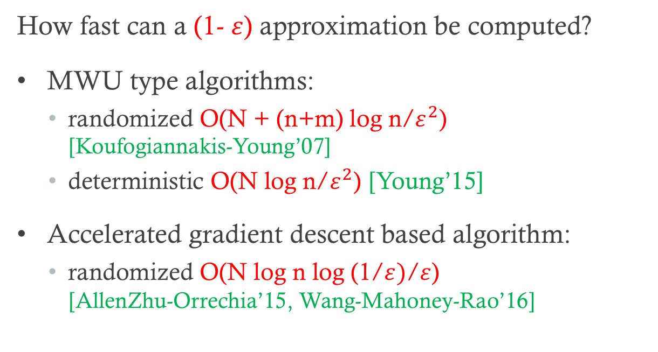
Explicit Packing/Covering LPs
How fast can a (1- $ε$) approximation be computed?
MWU type algorithms:
  randomized O(N + (n+m) log n/$ε^{2}$) [Koufogiannakis-Young’07]
  deterministic O(N log n/$ε^{2}$) [Young’15]
Accelerated gradient descent based algorithm:
  randomized O(N log n log (1/$ε)$/$ε$) [AllenZhu-Orrechia’15, Wang-Mahoney-Rao’16]

Slide 11

Explicit Positive LPs
How fast can a (1- $ε$) approximation be computed?
MWU based algorithms:
  deterministic O(N log n/$ε^{2}$) [Young’15]

Slide 12
Implicit Problems
Matrices A and B defined implicitly by a combinatorial structure
N is “large” in terms of original input
This talk: focus on packing problems

Slide 13
Packing Spanning Trees
Input: graph G=(V,E) edge capacities c_{e}
Goal: find a max fractional packing of spanning trees

Slide 14
Interval Packing
n closed intervals I₁, I₂, …, I_{n}: I_{i} = [a_{i}, b_{i}]
  I_{i} has size d_{i} and value v_{i}
m points p₁, p₂, …, p_{m} on real line
  p_{j} has capacity c_{j}

Slide 15
Interval Packing LP

Slide 16
TSP and Metric-TSP
TSP: Undir graph G=(V,E), edge costs c_{e}
  find Hamiltonian Cycle in G of minimum cost
Metric-TSP: Undir graph G=(V,E), edge costs c_{e}
  find spanning tour in G of minimum cost
  same as Hamiltonian Cycle in metric completion of G

Slide 17
Subtour Elimination LP for TSP

Slide 18
2ECSS LP
For Metric-TSP solving 2ECSS LP is equivalent to solving Subtour LP

Slide 19
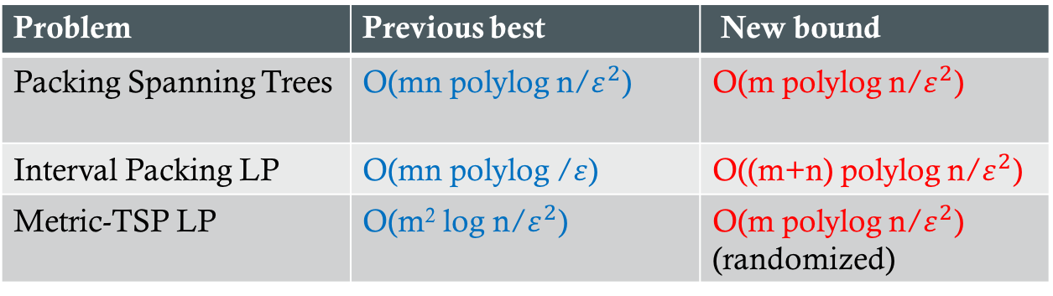
Faster Algorithms
Problem | Previous best | New bound
Packing Spanning Trees | O(mn polylog n/$ε^{2}$) | O(m polylog n/$ε^{2}$)
Interval Packing LP | O(mn polylog /$ε$) | O((m+n) polylog n/$ε^{2}$)
Metric-TSP LP | O(m² log n/$ε^{2}$) | O(m polylog n/$ε^{2}$) (randomized)
Ideas extend to positive LPs
Several other applications to LPs for combinatorial problems

Slide 20
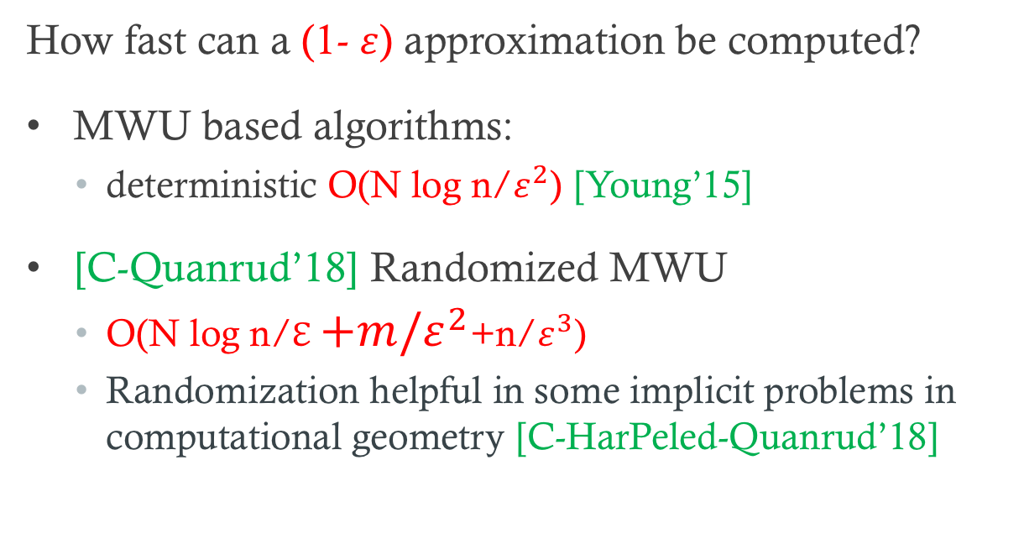
Explicit Positive LPs
How fast can a (1- $ε$) approximation be computed?
MWU based algorithms:
  deterministic O(N log n/$ε^{2}$) [Young’15]
[C-Quanrud’18] Randomized MWU
  O(N log n/ℇ$+m/ε^{2}$+n/$ε^{3}$)
  Randomization helpful in some implicit problems in computational geometry [C-HarPeled-Quanrud’18]

Slide 21
High-level Ideas
Speed up classical MWU based approximation schemes
Problem-specific integration of dynamic data structures for two separate issues
  oracle for MWU
  lazy weight update

Slide 22
Packing Spanning Trees

Slide 23
Packing Spanning Trees
Input: graph G=(V,E) edge capacities c_{e}
Goal: find a max fractional packing of spanning trees

Slide 24
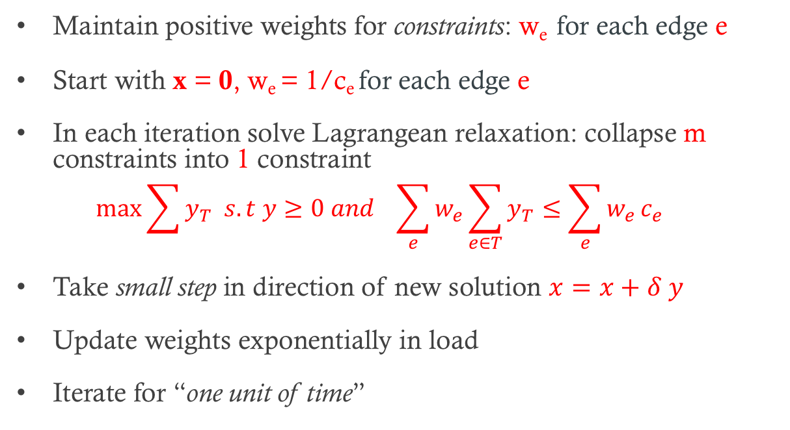
MWU Approach
Maintain positive weights for constraints: w_{e} for each edge e
Start with x = 0, w_{e} = 1/c_{e} for each edge e
In each iteration solve Lagrangean relaxation: collapse m constraints into 1 constraint
  $$\max{\sum{y_{T} s.t y≥0 and \sum_{e}{w_{e}\sum_{e∈T}{y_{T}≤\sum_{e}{w_{e}}c_{e}}}}}$$
Take small step in direction of new solution $x=x+δ y$
Update weights exponentially in load
Iterate for “one unit of time”

Slide 25
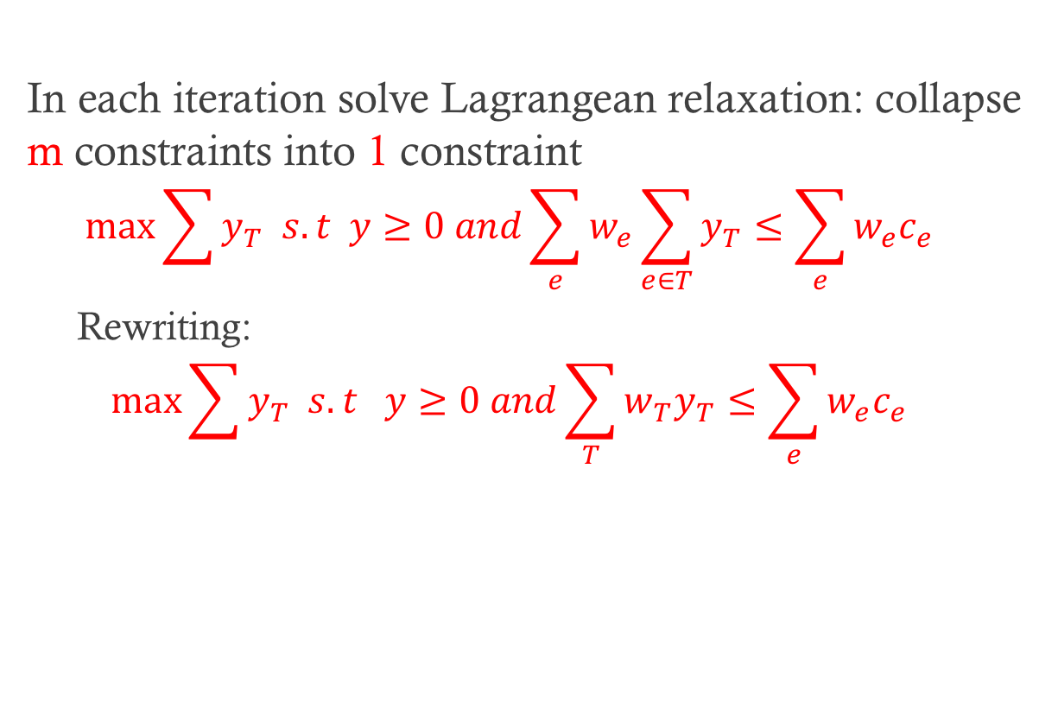
Solving Lagrangean Relaxation
In each iteration solve Lagrangean relaxation: collapse m constraints into 1 constraint
  $$\max{\sum{y_{T} s.t y≥0 and\sum_{e}{w_{e}\sum_{e∈T}{y_{T}≤\sum_{e}{w_{e}c_{e}}}}}}$$
  Rewriting:
  $$\max{\sum{y_{T} s.t y≥0 and\sum_{T}{w_{T}y_{T}≤\sum_{e}{w_{e}c_{e}}}}}$$
Optimum solution: T* that is MST wrt to weights w_{e}

Slide 26
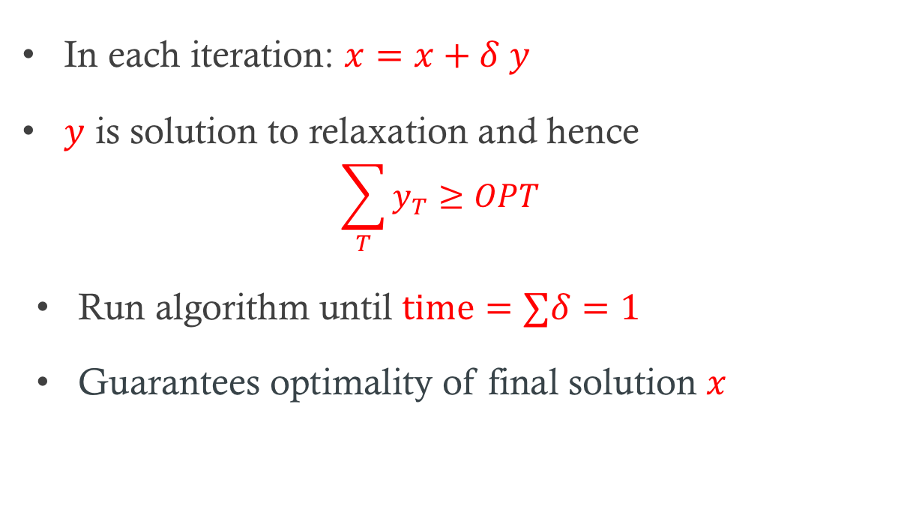
How many iterations?
In each iteration: $x=x+δ y$
$y$ is solution to relaxation and hence
  $$\sum_{T}{y_{T}≥OPT}$$
Run algorithm until $time=∑δ=1$
Guarantees optimality of final solution $x$

Slide 27
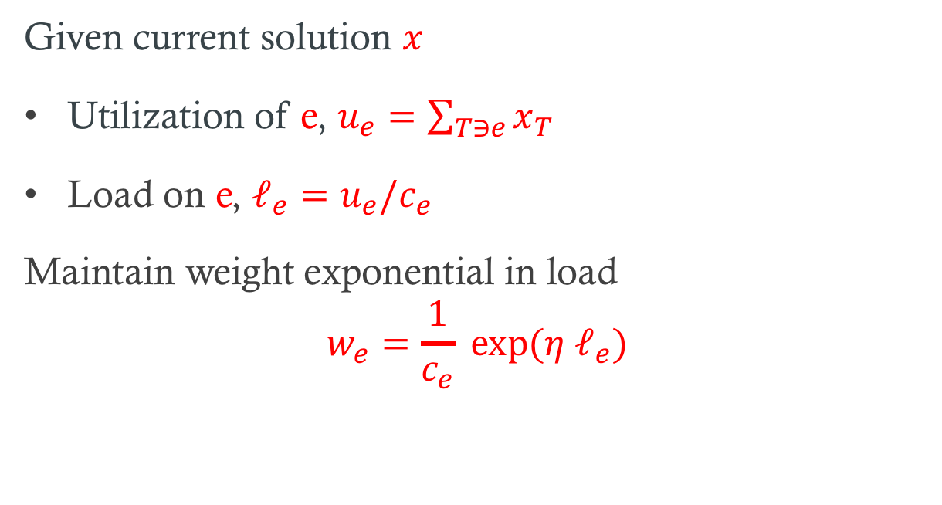
Weight and Load
Given current solution $x$
Utilization of e, $u_{e}=\sum_{T∋e}{x_{T}}$
Load on e, $ℓ_{e}=u_{e}/c_{e}$
Maintain weight exponential in load
$$w_{e}=\frac{1}{c_{e}} exp⁡(η ℓ_{e})$$

Slide 28
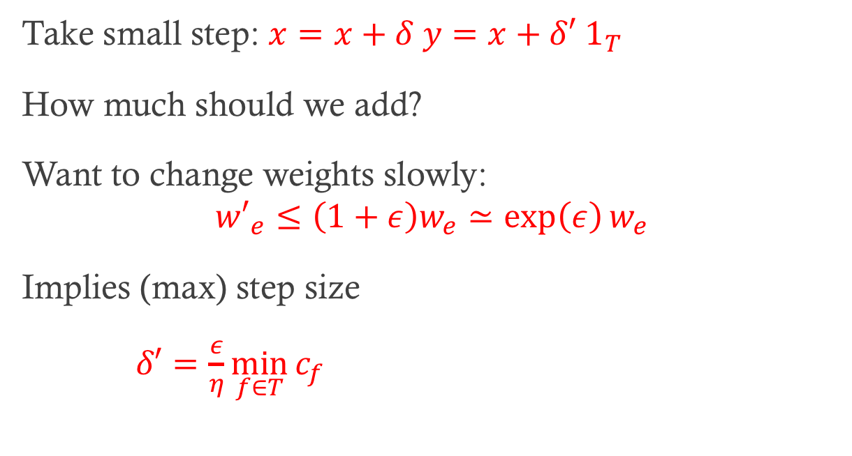
Step size
Take small step: $x=x+δ y=x+δ′ 1_{T}$
How much should we add?
Want to change weights slowly:
$${w′}_{e}≤\left(1+ε\right)w_{e}≃\exp\left(ε\right)w_{e}$$
Implies (max) step size
$δ′=\frac{ε}{η}\min_{f∈T}{c_{f}}$

Slide 29
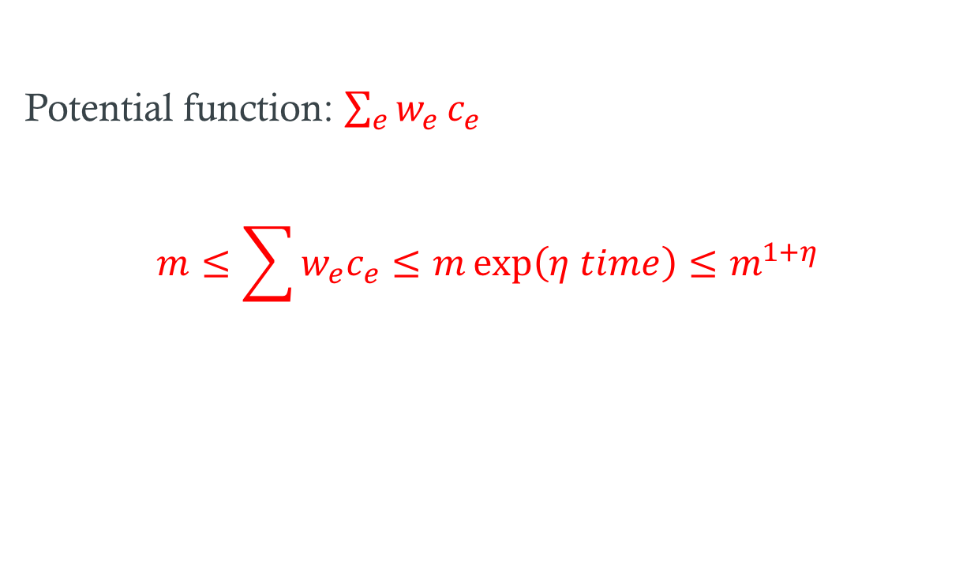
Potential Function
Potential function: $\sum_{e}{w_{e}}c_{e}$
$$m≤\sum{w_{e}c_{e}≤m\exp\left(η time\right)≤m^{1+η}}$$

Slide 30
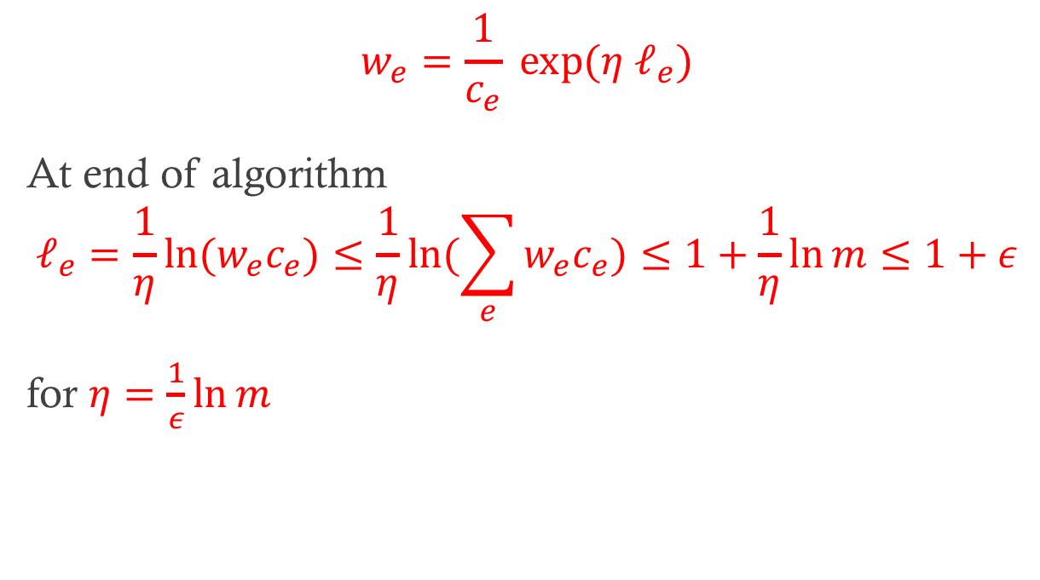
Constraint Violation
$$w_{e}=\frac{1}{c_{e}} exp⁡(η ℓ_{e})$$
At end of algorithm
$$ℓ_{e}=\frac{1}{η}\ln{{(w}_{e}c_{e})≤\frac{1}{η}ln{(\sum_{e}{w_{e}c_{e})≤1+\frac{1}{η}ln⁡m≤1+ε}}}$$
for $η=\frac{1}{ε}\ln{m }$

Slide 31
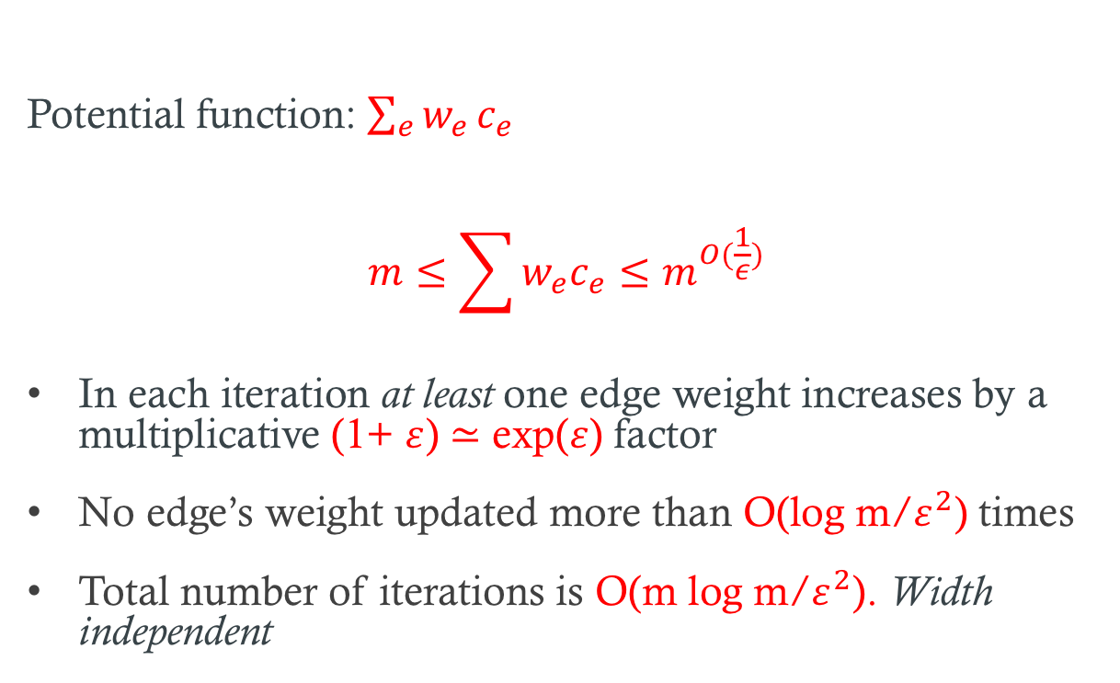
Potential Function
Potential function: $\sum_{e}{w_{e}}c_{e}$
$$m≤\sum{w_{e}c_{e}≤m^{O(\frac{1}{ε})}}$$
In each iteration at least one edge weight increases by a multiplicative (1+ $ε$) $≃$ exp($ε$) factor
No edge’s weight updated more than O(log m/$ε^{2}$) times
Total number of iterations is O(m log m/$ε^{2}$). Width independent

Slide 32
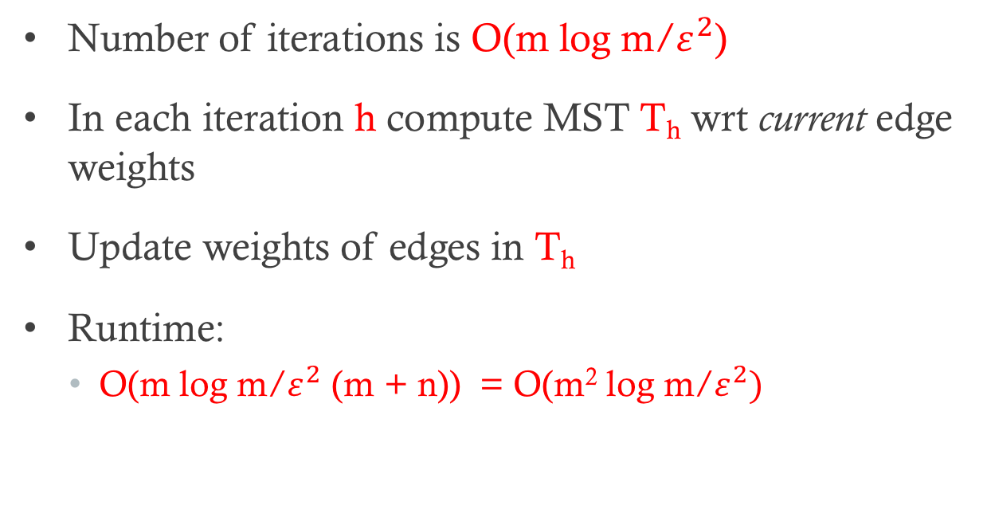
Run-time Analysis
Number of iterations is O(m log m/$ε^{2}$)
In each iteration h compute MST T_{h} wrt current edge weights
Update weights of edges in T_{h}
Runtime:
  O(m log m/$ε^{2}$ (m + n)) = O(m² log m/$ε^{2})$

Slide 33
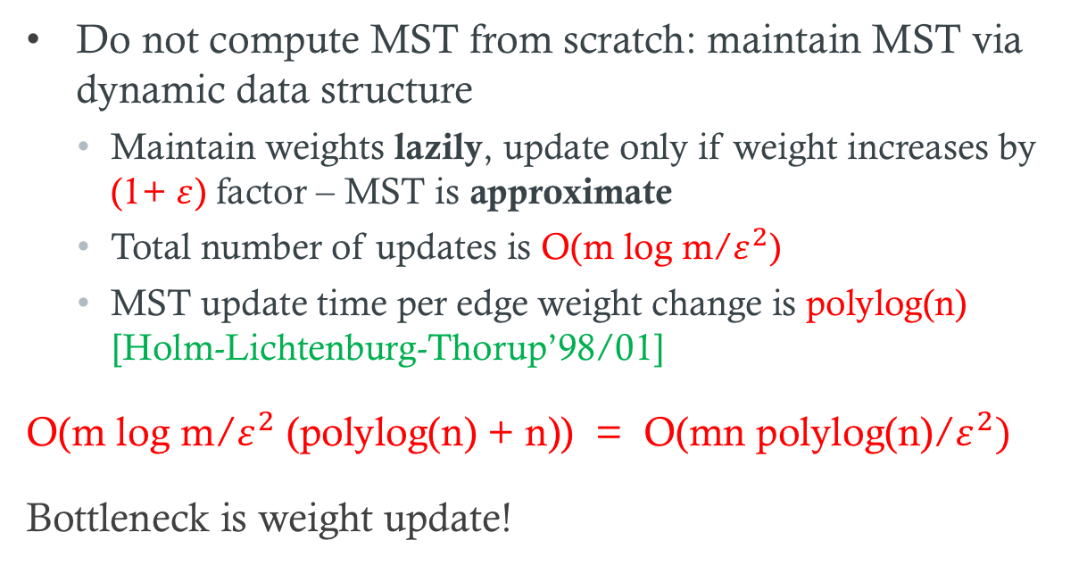
Improving run time via data structures
Do not compute MST from scratch: maintain MST via dynamic data structure
  Maintain weights lazily, update only if weight increases by (1+ $ε$) factor – MST is approximate
  Total number of updates is O(m log m/$ε^{2}$)
  MST update time per edge weight change is polylog(n) [Holm-Lichtenburg-Thorup’98/01]
O(m log m/$ε^{2}$ (polylog(n) + n)) = O(mn polylog(n)/$ε^{2})$
Bottleneck is weight update!

Slide 34
Updating weights in each iteration

Slide 35
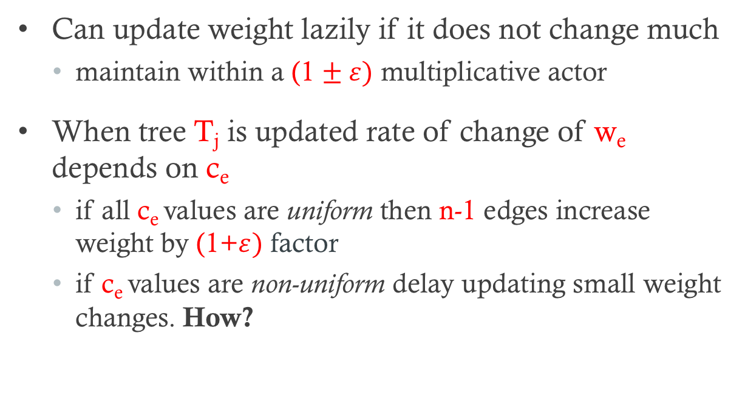
Updating weights lazily
Can update weight lazily if it does not change much
  maintain within a (1 $± ε)$ multiplicative actor
When tree T_{j} is updated rate of change of w_{e} depends on c_{e}
  if all c_{e} values are uniform then n-1 edges increase weight by (1+$ε)$ factor
  if c_{e} values are non-uniform delay updating small weight changes. How?

Slide 36
Updating weights lazily
Borrow ideas from [Koufagiannis-Young’07,Young’15] for explicit problems
Deterministically: Bucket c_{e} values geometrically and lazily update using amortization. Somewhat involved to describe. Take advantage of {0,1} structure of A
Randomization: touch/update w_{e} in proportion to 1/c_{e}.

Slide 37
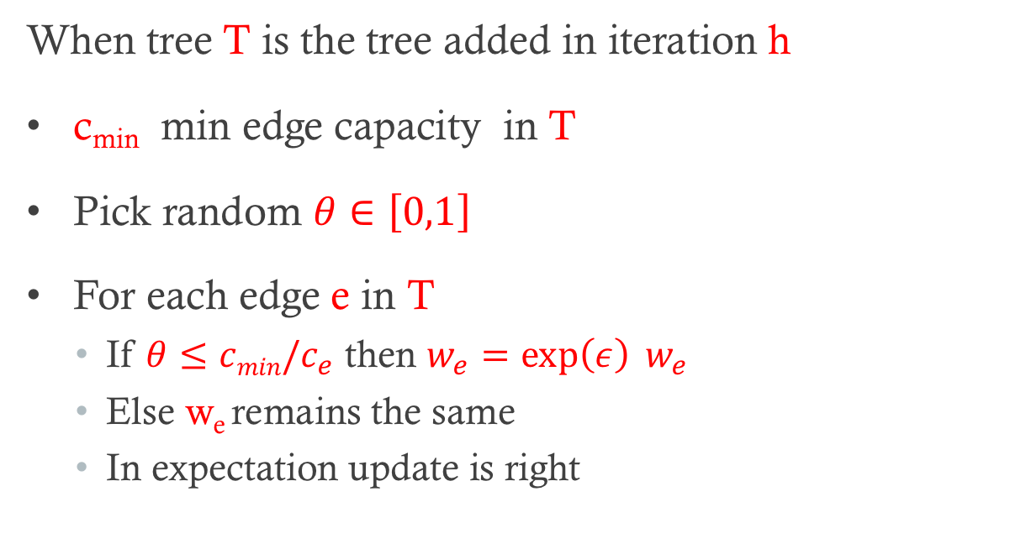
Randomized weight update
When tree T is the tree added in iteration h
c_{min} min edge capacity in T
Pick random $θ∈\left[0,1\right]$
For each edge e in T
  If $θ≤cmin/c_{e}$ then $w_{e}=\exp\left(ε\right) w_{e}$
  Else w_{e} remains the same
  In expectation update is right

Slide 38
Updating weights in each iteration

Slide 39
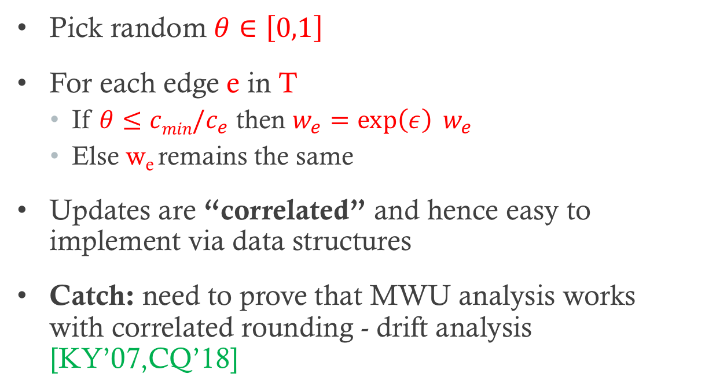
Randomized weight update
Pick random $θ∈\left[0,1\right]$
For each edge e in T
  If $θ≤cmin/c_{e}$ then $w_{e}=\exp\left(ε\right) w_{e}$
  Else w_{e} remains the same
Updates are “correlated” and hence easy to implement via data structures
Catch: need to prove that MWU analysis works with correlated rounding - drift analysis [KY’07,CQ’18]

Slide 40
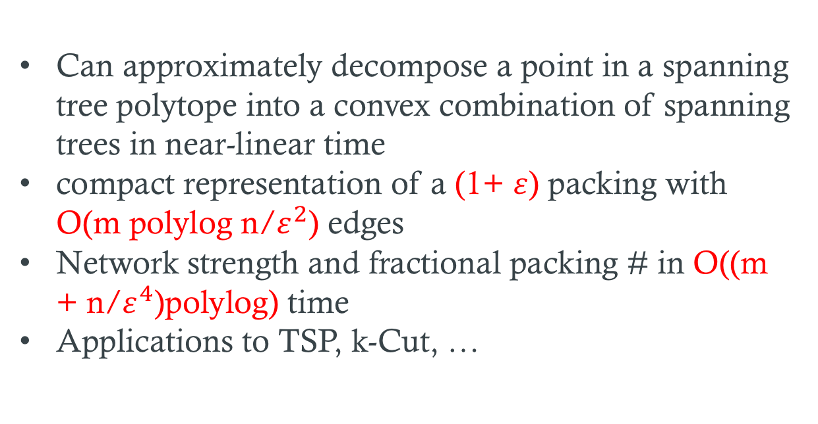
Packing Spanning Trees:
Related Results and Applications
Can approximately decompose a point in a spanning tree polytope into a convex combination of spanning trees in near-linear time
compact representation of a (1+ $ε$) packing with O(m polylog n/$ε^{2}$) edges
Network strength and fractional packing # in O((m + n/$ε^{4}$)polylog) time
Applications to TSP, k-Cut, …

Slide 41
Metric-TSP

Slide 42
2ECSS LP
For Metric-TSP solving 2ECSS LP is equivalent to solving Subtour LP

Slide 43
Dual of 2ECSS LP
Packing cuts into capacities
Separation oracle is global mincut

Slide 44
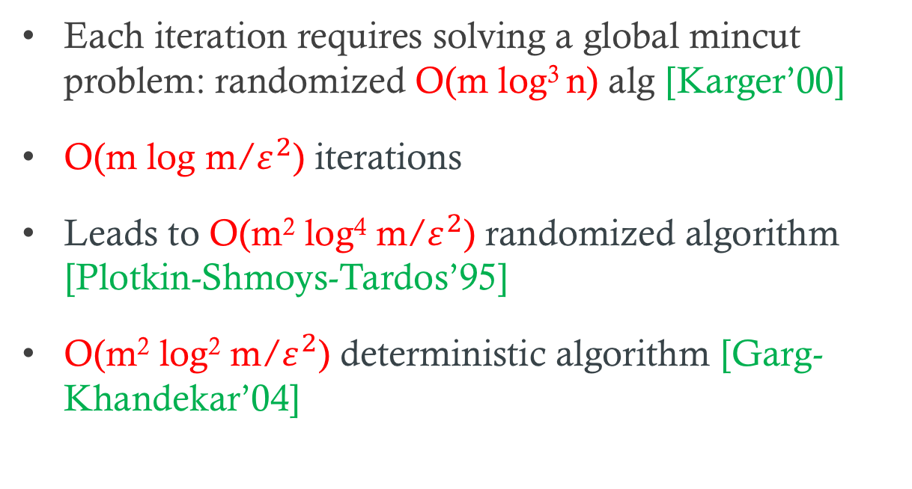
MWU Algorithms
Each iteration requires solving a global mincut problem: randomized O(m log³ n) alg [Karger’00]
O(m log m/$ε^{2}$) iterations
Leads to O(m² log⁴ m/$ε^{2}$) randomized algorithm [Plotkin-Shmoys-Tardos’95]
O(m² log² m/$ε^{2}$) deterministic algorithm [Garg-Khandekar’04]

Slide 45
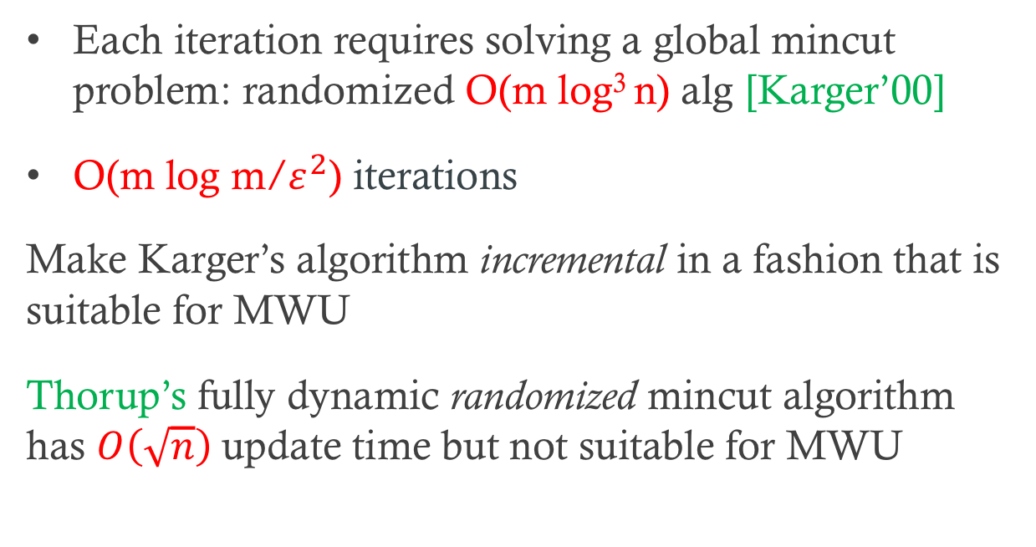
Our Approach
Each iteration requires solving a global mincut problem: randomized O(m log³ n) alg [Karger’00]
O(m log m/$ε^{2}$) iterations
Make Karger’s algorithm incremental in a fashion that is suitable for MWU
Thorup’s fully dynamic randomized mincut algorithm has $O\left(\sqrt{n}\right)$update time but not suitable for MWU

Slide 46
Karger’s mincut algorithm
Not the contraction algorithm!
Given G=(V,E) compute (randomly) a sparsifier H=(V,E’) s.t that mincut of H is O(log n) and cuts are preserved
Compute k=O(log n/ε²) spanning trees T₁,..,T_{k} that (1-ε)-approximate max tree packing in H
By Tutte-NashWilliams theorem there is an i such that T_{i} 2-respects a mincut of G
Clever DP on each tree T_{j} to find smallest cut of G that 2-respects T_{j} in O(m log² n) time

Slide 47
Christofides Heuristic for Metric-TSP

Slide 48
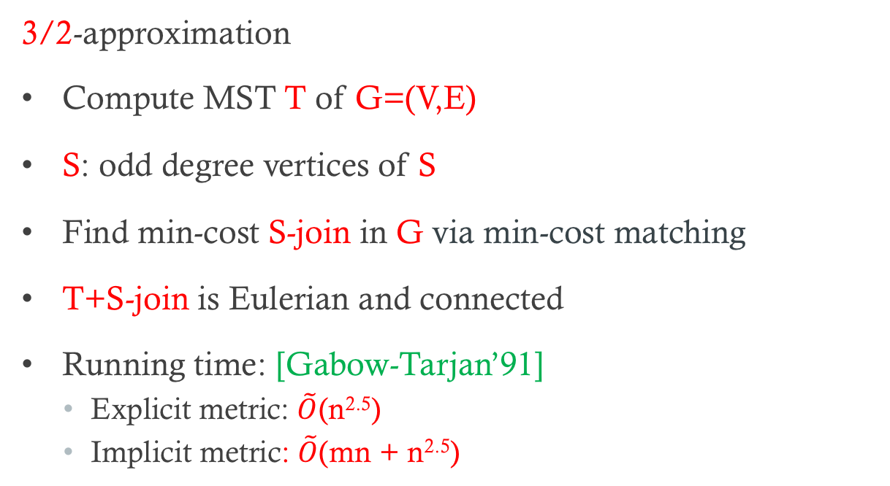
Christofides Heuristic for Metric-TSP
3/2-approximation
Compute MST T of G=(V,E)
S: odd degree vertices of S
Find min-cost S-join in G via min-cost matching
T+S-join is Eulerian and connected
Running time: [Gabow-Tarjan’91]
  Explicit metric: $\tilde{O}$(n^{2.5})
  Implicit metric: $\tilde{O}$(mn + n^{2.5})

Slide 49
Christofides Heuristic: Faster Implementation via LP
Compute MST T of G=(V,E)
S: odd degree vertices of S
Solve LP to find solution x
Sparsify via [Benczur-Karger] to reduce support of x to O(n log n) edges
Find min-cost S-join in sparsified graph via reduction to min-cost matching: O(n log n) sized graph
T+S-join is Eulerian and connected
Use [Wolsey’80] for analysis wrt to LP

Slide 50
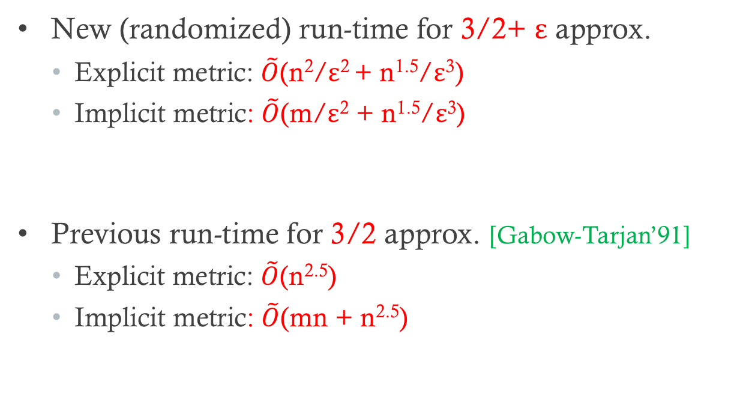
Christofides Heuristic: Faster Implementation via LP
New (randomized) run-time for 3/2+ ε approx.
  Explicit metric: $\tilde{O}$(n²/ε² + n^{1.5}/ε³)
  Implicit metric: $\tilde{O}$(m/ε² + n^{1.5}/ε³)
Previous run-time for 3/2 approx. [Gabow-Tarjan’91]
  Explicit metric: $\tilde{O}$(n^{2.5})
  Implicit metric: $\tilde{O}$(mn + n^{2.5})

Slide 51
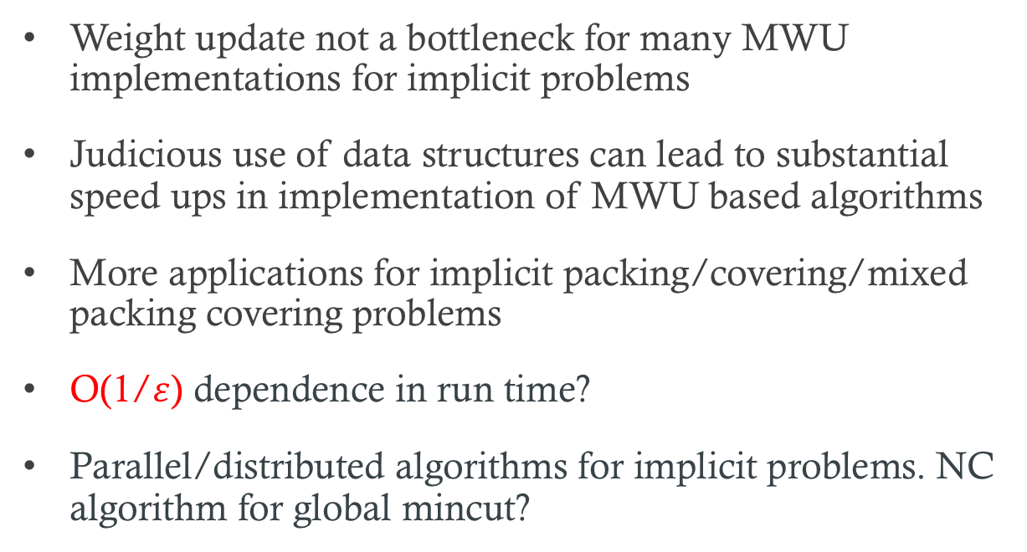
Remarks and Open Problems
Weight update not a bottleneck for many MWU implementations for implicit problems
Judicious use of data structures can lead to substantial speed ups in implementation of MWU based algorithms
More applications for implicit packing/covering/mixed packing covering problems
O(1/$ε$) dependence in run time?
Parallel/distributed algorithms for implicit problems. NC algorithm for global mincut?

Slide 52
Thank You!

