Slide 1
Tree packing, mincut, and Metric-TSP
Chandra Chekuri
Univ. of Illinois, Urbana-Champaign
Joint work with Kent Quanrud

Slide 2
TSP and Metric-TSP
TSP: Undir graph G=(V,E), edge costs c_{e}
  find Hamiltonian Cycle in G of minimum cost
  Inapproximable
Metric-TSP: Undir graph G=(V,E), edge costs c_{e}
  find spanning tour in G of minimum cost
  same as Hamiltonian Cycle in metric completion of G
  APX-Hard and constant factor known

Slide 3
Approximating Metric-TSP
3/2 approximation: Christofides heuristic (1976)
Conjecture: 4/3 approximation via LP relaxation
Recent exciting progress on graphic-TSP, s-t-Path-TSP, ATSP etc. Mostly based on LP relaxations.

Slide 4
Subtour Elimination LP for TSP
[Dantzig-Fulkerson-Johnson 1954]

Slide 5
2ECSS LP
Metric-TSP: 2ECSS LP is equivalent to Subtour LP
[Cunningham, Bertsimas-Goemans]

Slide 6
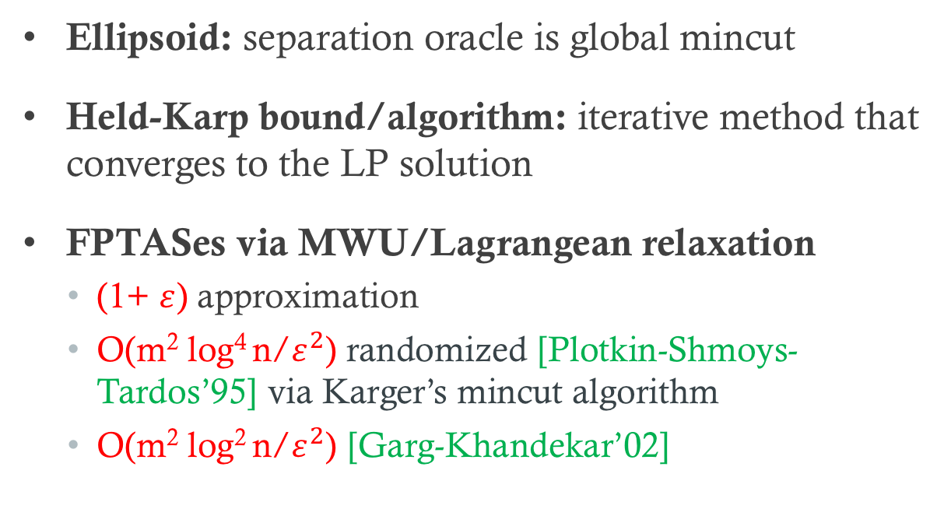
Solving the LP
Ellipsoid: separation oracle is global mincut
Held-Karp bound/algorithm: iterative method that converges to the LP solution
FPTASes via MWU/Lagrangean relaxation
  (1+ $ε$) approximation
  O(m² log⁴ n/$ε^{2}$) randomized [Plotkin-Shmoys-Tardos’95] via Karger’s mincut algorithm
  O(m² log² n/$ε^{2}$) [Garg-Khandekar’02]

Slide 7
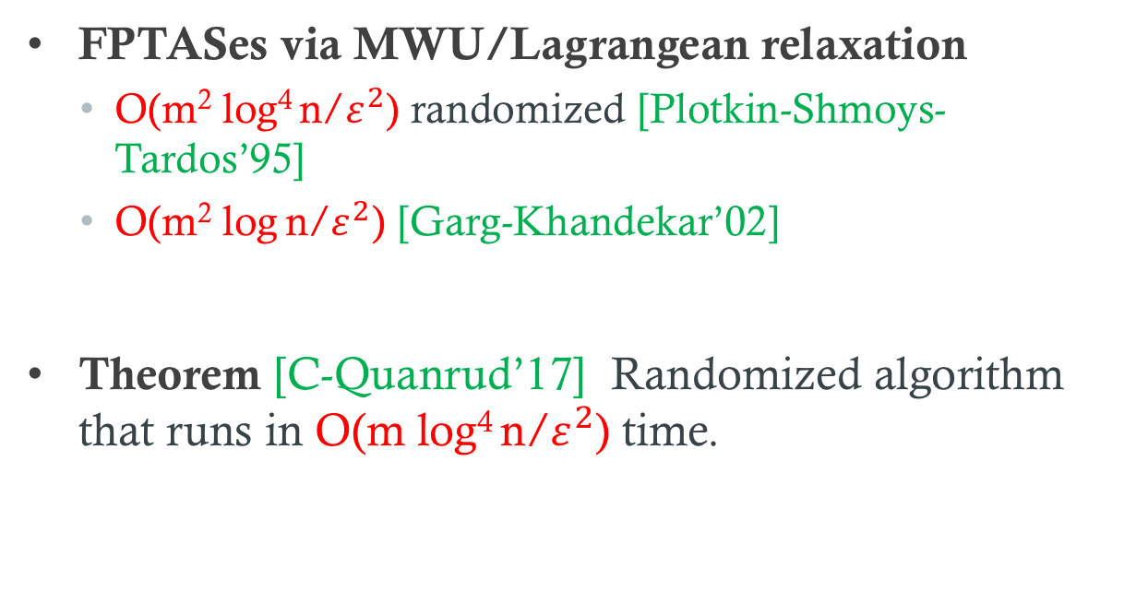
Solving the LP
FPTASes via MWU/Lagrangean relaxation
  O(m² log⁴ n/$ε^{2}$) randomized [Plotkin-Shmoys-Tardos’95]
  O(m² log n/$ε^{2}$) [Garg-Khandekar’02]
Theorem [C-Quanrud’17] Randomized algorithm that runs in O(m log⁴ n/$ε^{2}$) time.

Slide 8
Dual of 2ECSS LP
Packing cuts into capacities

Slide 9
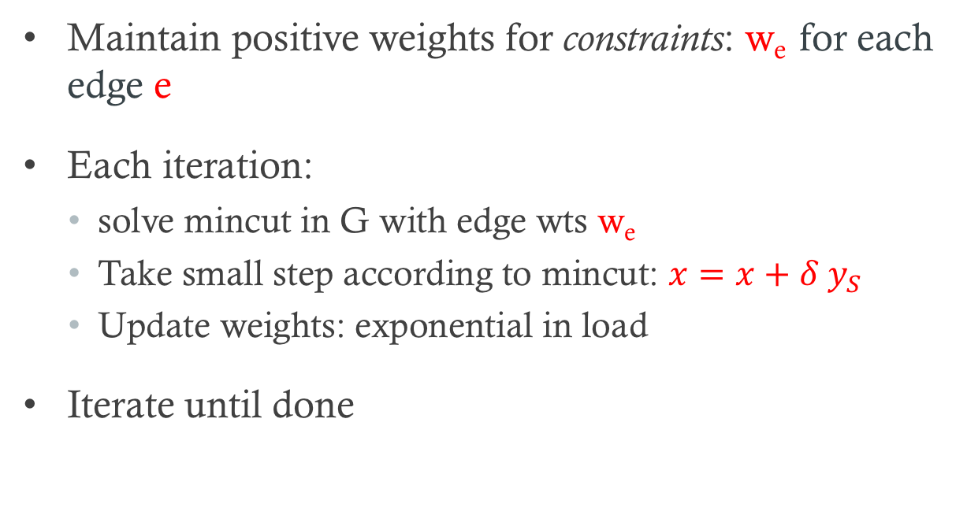
MWU Approach
Maintain positive weights for constraints: w_{e} for each edge e
Each iteration:
  solve mincut in G with edge wts w_{e}
  Take small step according to mincut: $x=x+δ y_{S}$
  Update weights: exponential in load
Iterate until done

Slide 10
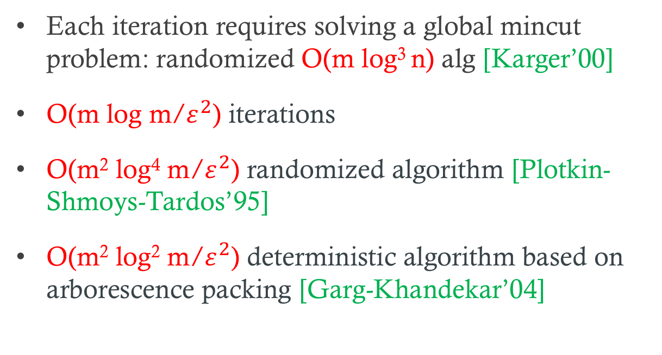
MWU Approach
Each iteration requires solving a global mincut problem: randomized O(m log³ n) alg [Karger’00]
O(m log m/$ε^{2}$) iterations
O(m² log⁴ m/$ε^{2}$) randomized algorithm [Plotkin-Shmoys-Tardos’95]
O(m² log² m/$ε^{2}$) deterministic algorithm based on arborescence packing [Garg-Khandekar’04]

Slide 11
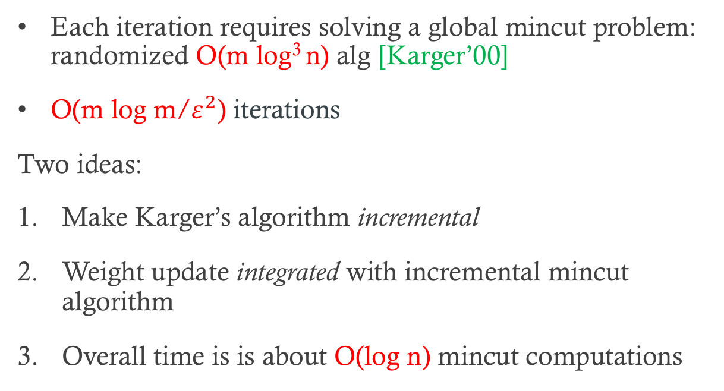
Our Approach
Each iteration requires solving a global mincut problem: randomized O(m log³ n) alg [Karger’00]
O(m log m/$ε^{2}$) iterations
Two ideas:
Make Karger’s algorithm incremental
Weight update integrated with incremental mincut algorithm
Overall time is is about O(log n) mincut computations

Slide 12
High-level Ideas for MWU
Speed up classical MWU based approximation schemes for implicit problems
Problem-specific integration of dynamic data structures for two separate issues
  oracle for MWU
  (lazy) weight update
Inspired by [Koufagiannis-Young’07, Young’15] for weight update, and other work on MWU [Madry’10, Agarwal-Pan’14 …]

Slide 13
Karger’s near-linear time mincut algorithm
[STOC’96, JACM’00]
Not a random contraction algorithm!
O(m log³ n) time randomized algorithm
Based on tree packings and dynamic programming

Slide 14
Packing Spanning Trees
Input: graph G=(V,E) edge capacities c_{e}
Goal: find a max fractional packing of spanning trees

Slide 15

Tutte-NashWilliams Theorem
packing value:$τ\left(G\right)=\min_{P}{\frac{E(P)}{\left|P\right|−1}}$
Corollary: τ(G) ≥ (n-1)λ(G)/2n > λ(G)/2

Slide 16
Useful corollary
Lemma [Karger]: Fix a mincut δ(S*). In a 4/5-approximate tree packing, a tree T chosen at random from the packing, with probability at least a fixed constant c, intersects δ(S) in at most 2 edges.
V\S*
S*

Slide 17
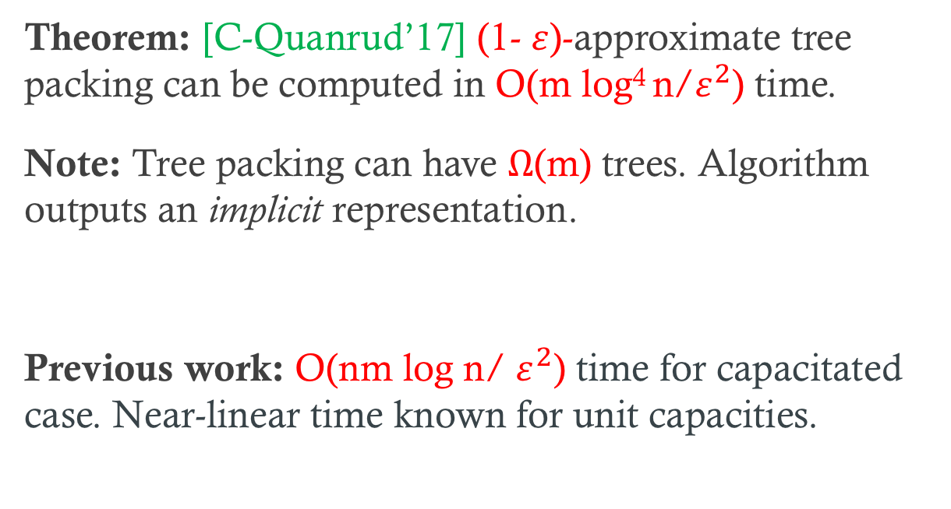
Packing Spanning Trees
Theorem: [C-Quanrud’17] (1- $ε$)-approximate tree packing can be computed in O(m log⁴ n/$ε^{2}$) time.
Note: Tree packing can have $Ω$(m) trees. Algorithm outputs an implicit representation.
Previous work: O(nm log n/ $ε^{2}$) time for capacitated case. Near-linear time known for unit capacities.

Slide 18
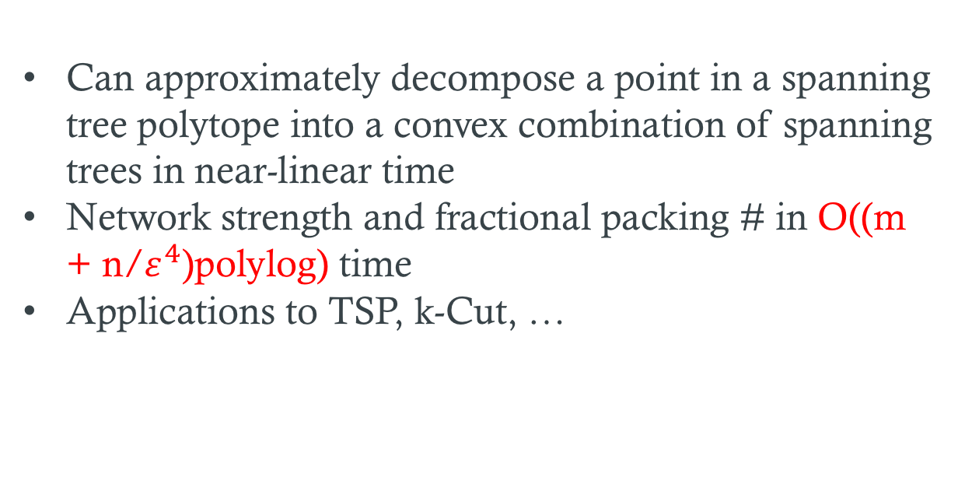
Packing Spanning Trees:
Related Results and Applications
Can approximately decompose a point in a spanning tree polytope into a convex combination of spanning trees in near-linear time
Network strength and fractional packing # in O((m + n/$ε^{4}$)polylog) time
Applications to TSP, k-Cut, …

Slide 19
Karger’s mincut algorithm
Randomly sparsify G to obtain unweighted graph H with λ(H) = O(log n)
Find tree packing in H to obtain O(log n) trees T₁, T₂, …, T _{c log n}
For each T_{i}
  Use clever dynamic programming algorithm to find smallest cut of G that 2-respects T_{i} in O(m log² n) time
Output cheapest cut found over all trees

Slide 20
Karger’s mincut algorithm redone
Given G=(V,E) compute 4/5-approximate tree packing in O(m log³ n) time using [CQ’17]
Pick a tree T at random from the packing
Use Karger’s clever dynamic programming algorithm to find smallest cut of G that 2-respects T in O(m log² n) time
Repeat steps 2,3 Θ(log n) times

Slide 21
MWU for Packing Spanning trees and Metric-TSP
Both packing problems: pack trees or cuts into capacities.
MWU alg maintains weight w_{e} for each edge e where w_{e} is exponential in load x_{e}/c_{e}
Oracle: MST and Mincut
After each iteration need to update weights of new spanning tree or new mincut
Total # of iterations O(m log m/ε²)

Slide 22
Speeding up and bottlenecks
MWU weight increase monotonically
Suffice to output a (1+ε) approximate MST/Mincut
Maintain incremental data structure for MST/Mincut
Update weight in data structure only if it increases by a (1+ε) multiplicative factor. Charge data structure operations to MWU potential function
Bottleneck: Updating weights even if data structure is free!

Slide 23
Spanning Trees
Dynamic MST: Can update MST as weights change in O(polylog(n)) per edge update [Thorup, Holm-Lichtenberg-Thorup’01]
Advantage of MSTs: weight of one edge changes, new MST is one edge-swap from old one
Bottleneck: Updating weights even if data structure is free!

Slide 24
Updating weights in each iteration

Slide 25
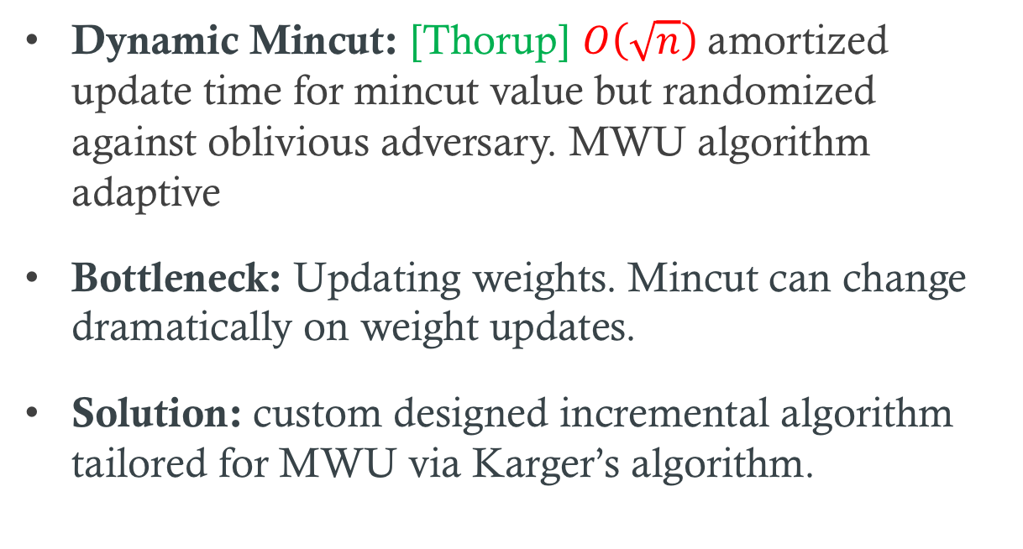
Mincuts
Dynamic Mincut: [Thorup] $O\left(\sqrt{n}\right)$amortized update time for mincut value but randomized against oblivious adversary. MWU algorithm adaptive
Bottleneck: Updating weights. Mincut can change dramatically on weight updates.
Solution: custom designed incremental algorithm tailored for MWU via Karger’s algorithm.

Slide 27
Faster Approximation for Metric-TSP via LP

Slide 28
Christofides Heuristic for Metric-TSP

Slide 29
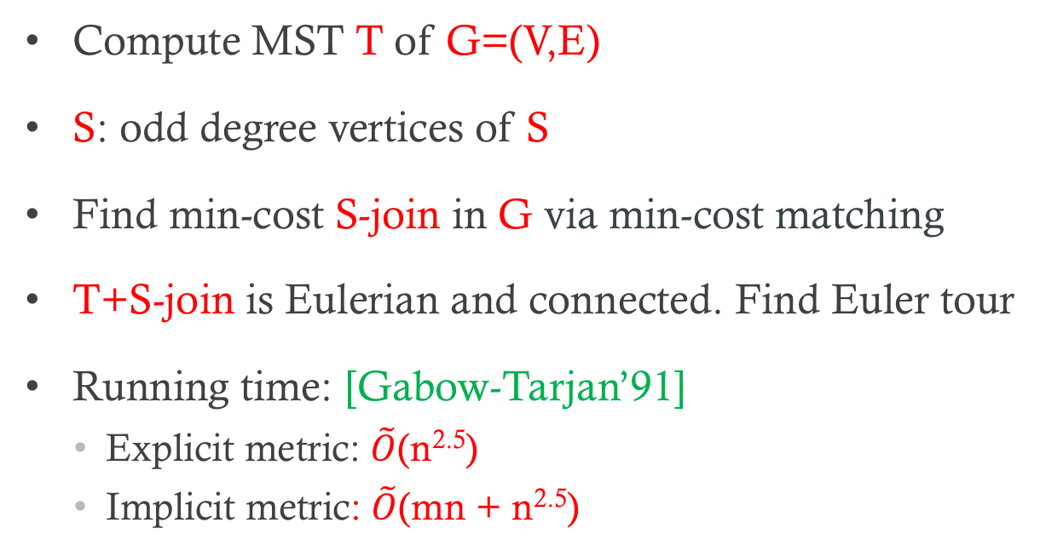
Christofides Heuristic
Compute MST T of G=(V,E)
S: odd degree vertices of S
Find min-cost S-join in G via min-cost matching
T+S-join is Eulerian and connected. Find Euler tour
Running time: [Gabow-Tarjan’91]
  Explicit metric: $\tilde{O}$(n^{2.5})
  Implicit metric: $\tilde{O}$(mn + n^{2.5})

Slide 30
Christofides Heuristic and LP
[Wolsey’80]
Compute MST T of G=(V,E): c(T) ≤ OPT_{LP}
S: odd degree vertices of S
Find min-cost S-join in G via min-cost matching
  For any spanning tree T, mincost S-join ≤ OPT_{LP} /2
T+S-join is Eulerian and connected. Find Euler tour

Slide 31
Christofides Heuristic: Faster Implementation via LP
Compute MST T of G=(V,E)
S: odd degree vertices of S
Solve LP to find solution x
Sparsify via [Benczur-Karger] to reduce support of x to O(n log n) edges
Find min-cost S-join in sparsified graph via reduction to min-cost matching: O(n log n) sized graph
T+S-join is Eulerian and connected

Slide 32
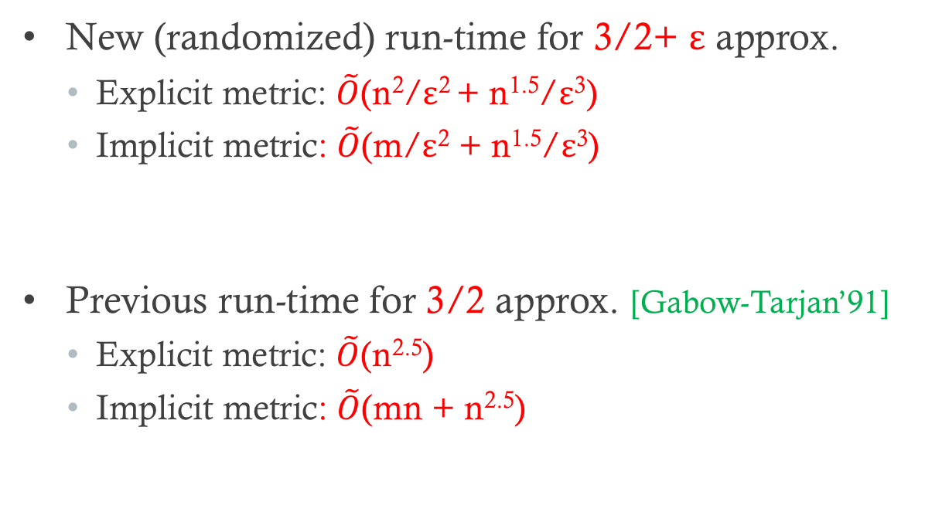
Christofides Heuristic: Faster Implementation via LP
New (randomized) run-time for 3/2+ ε approx.
  Explicit metric: $\tilde{O}$(n²/ε² + n^{1.5}/ε³)
  Implicit metric: $\tilde{O}$(m/ε² + n^{1.5}/ε³)
Previous run-time for 3/2 approx. [Gabow-Tarjan’91]
  Explicit metric: $\tilde{O}$(n^{2.5})
  Implicit metric: $\tilde{O}$(mn + n^{2.5})

Slide 33
Best of many Christofides Heuristics
Solve LP to find solution x
y = ((n-1)/n) x is in spanning tree polytope of G
Pick random spanning tree T with marginals y
Find min-cost S-join: S odd-degree nodes of T
T+S-join is Eulerian and connected

Slide 34
Best of many Christofides Heuristics
Pick random spanning tree T with marginals y
Decompose y into convex combination of trees
Swap-rounding wrt to convex combination
Max-entropy distribution according to y
Can implement steps 1, 2 in near-linear time

Slide 35
s-t Path TSP
Undir graph G=(V,E), edge costs c_{e}
Start node s, end node t
Find s-t spanning walk of minimum cost

Slide 36
Approximating s-t PathTSP
5/3 approx. via generalization of Christofides heuristic [Hoogeveen 91]
Conjecture: LP integrality gap is 3/2
[An-Kleinberg-Shmoys’12] (1+√5)/2 ≅ 1.618 approximation via best-of-many Christofied heuristic
[Sebo-vanZuylen’16] 3/2 + 1/34 via LP
[Traub-Vygen’18] 3/2 + ε via LP + DP

Slide 37
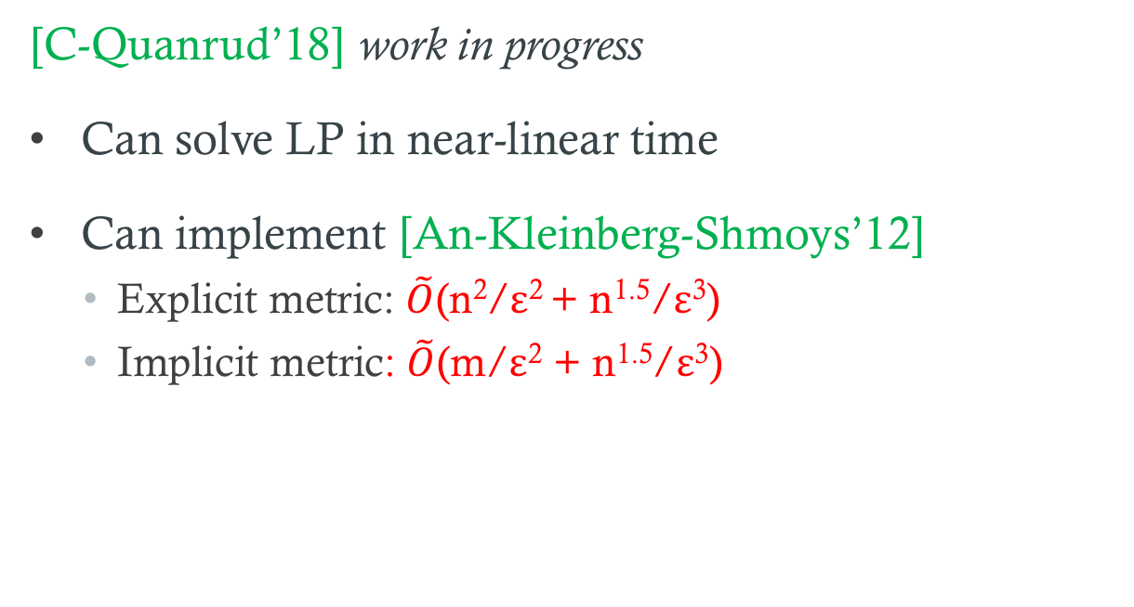
Approximating s-t PathTSP: Faster Algorithms
[C-Quanrud’18] work in progress
Can solve LP in near-linear time
Can implement [An-Kleinberg-Shmoys’12]
  Explicit metric: $\tilde{O}$(n²/ε² + n^{1.5}/ε³)
  Implicit metric: $\tilde{O}$(m/ε² + n^{1.5}/ε³)

Slide 38
Remarks and Open Problems
Judicious use of data structures can lead to substantial speed ups in implementation of MWU based algorithms
Solving LP faster than combinatorial algorithms in some cases!
Faster deterministic algorithm for mincut?
NC algorithm for global mincut?

Slide 39
Thank You!

