Slide 1
On Approximating
Covering Integer Programs
Chandra Chekuri
Univ. of Illinois, Urbana-Champaign
Joint work with Kent Quanrud
Workshop on Flexible Network Design, May 2018

Slide 2
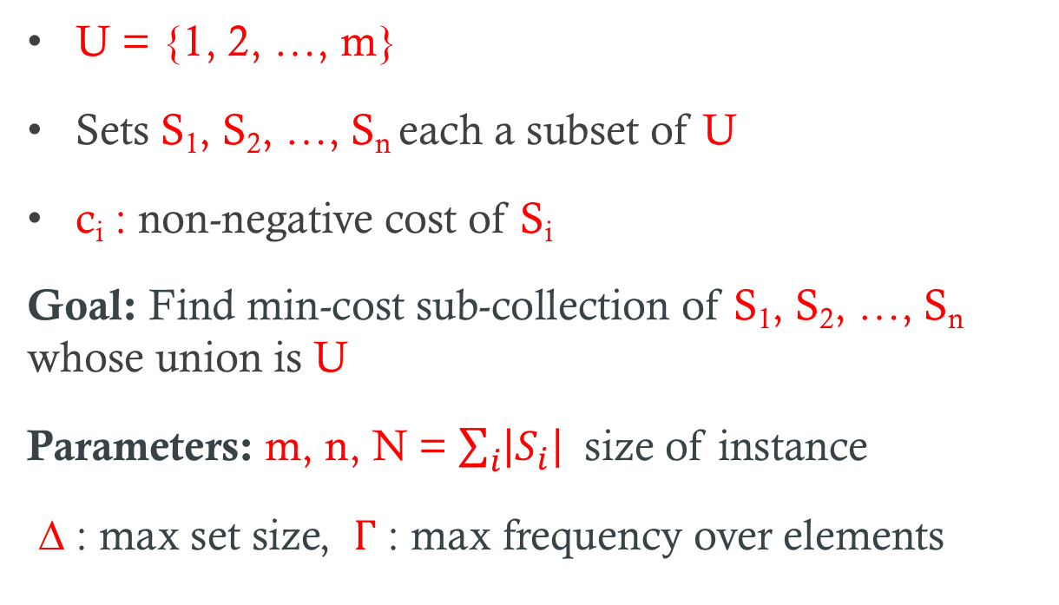
Set Cover
U = {1, 2, …, m}
Sets S₁, S₂, …, S_{n} each a subset of U
c_{i} : non-negative cost of S_{i}
Goal: Find min-cost sub-collection of S₁, S₂, …, S_{n} whose union is U
Parameters: m, n, N = $\sum_{i}{\left|S_{i}\right| }$ size of instance
∆ : max set size, Γ : max frequency over elements

Slide 3
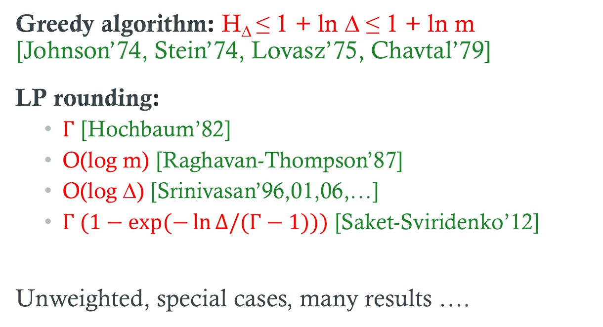
Approximating Set Cover
Greedy algorithm: H∆ ≤ 1 + ln ∆ ≤ 1 + ln m [Johnson’74, Stein’74, Lovasz’75, Chavtal’79]
LP rounding:
  Γ [Hochbaum’82]
  O(log m) [Raghavan-Thompson’87]
  O(log ∆) [Srinivasan’96,01,06,…]
  $Γ (1−exp⁡(−\ln{Δ/(Γ−1))})$[Saket-Sviridenko’12]
Unweighted, special cases, many results ….

Slide 4
Hardness of Approximation
No (1- ℇ) ln m approx. unless P = NP [Moshkovitz’15, Feige’98]
No ln ∆ - ln ln ∆ approx. unless P = NP [Trevisan’01]
No (Γ - ℇ) approx. under UGC [Bansal-Khot’10]
No (Γ – 1 - ℇ) approx. unless P = NP [Dinur et al’03]

Slide 5
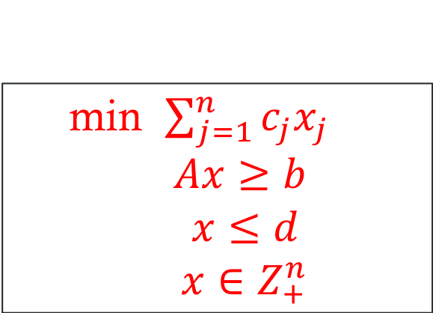
Covering Integer Programs
min $\sum_{j=1}^{n}{c_{j}x_{j}}$
$$Ax≥b$$
$x≤d$
$x∈Z_{+}^{n}$
$$A∈R_{+}^{m x n}, b∈R_{+}^{m}, d∈R_{+}^{n}, c∈R_{+}^{n}$$
CIP : with multiplicity constraints
CIP∞ : without multiplicity constraints, d_{j} = ∞

Slide 6
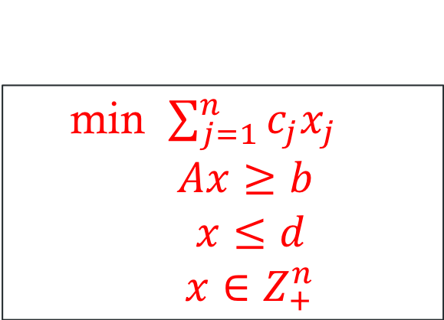
Normalization and Parameters
min $\sum_{j=1}^{n}{c_{j}x_{j}}$
$$Ax≥b$$
$x≤d$
$x∈Z_{+}^{n}$
$$A∈{\left[0,1\right]}_{}^{m x n}, b≥1, d∈Z_{+}^{n}, c∈R_{+}^{n}$$
∆₀ max # of non-zeroes in a column
∆₁ max column sum
Γ₀ max # of non-zeroes in a row
Γ₁ max row sum
Under normalization ∆₁ ≤ ∆₀ and Γ₁ ≤ Γ₀

Slide 7
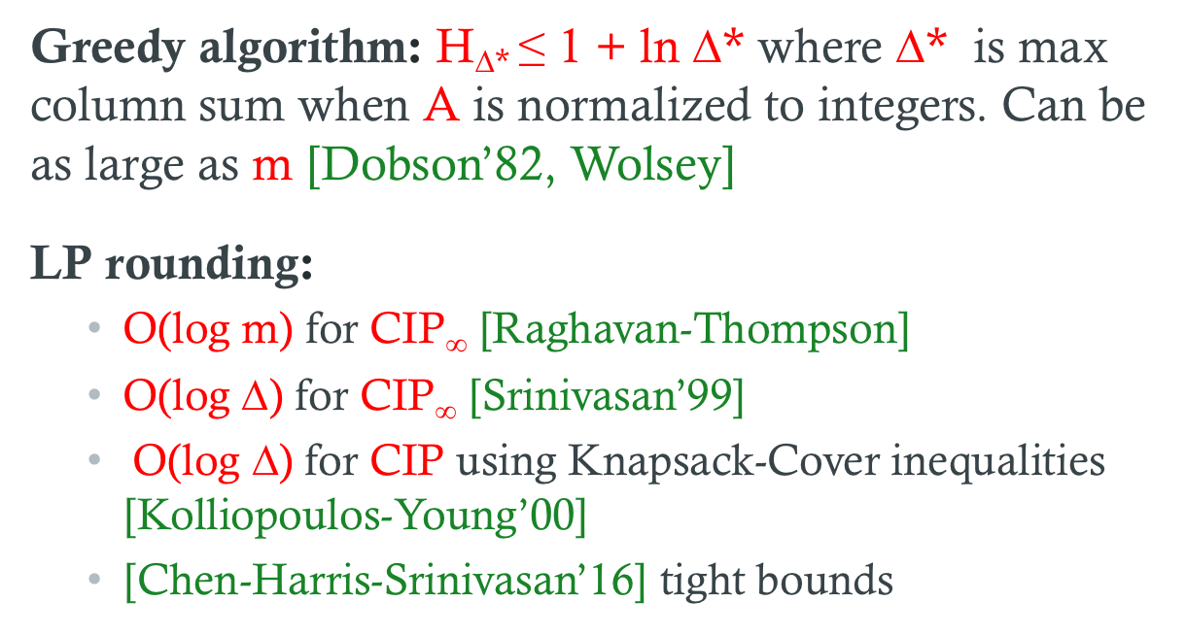
Approximating CIPs
Greedy algorithm: H∆* ≤ 1 + ln ∆* where ∆* is max column sum when A is normalized to integers. Can be as large as m [Dobson’82, Wolsey]
LP rounding:
  O(log m) for CIP∞ [Raghavan-Thompson]
  O(log ∆) for CIP∞ [Srinivasan’99]
  O(log ∆) for CIP using Knapsack-Cover inequalities [Kolliopoulos-Young’00]
  [Chen-Harris-Srinivasan’16] tight bounds

Slide 8
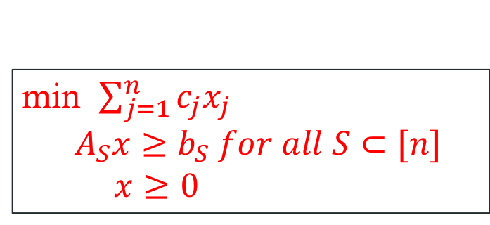
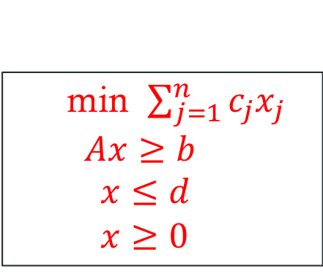
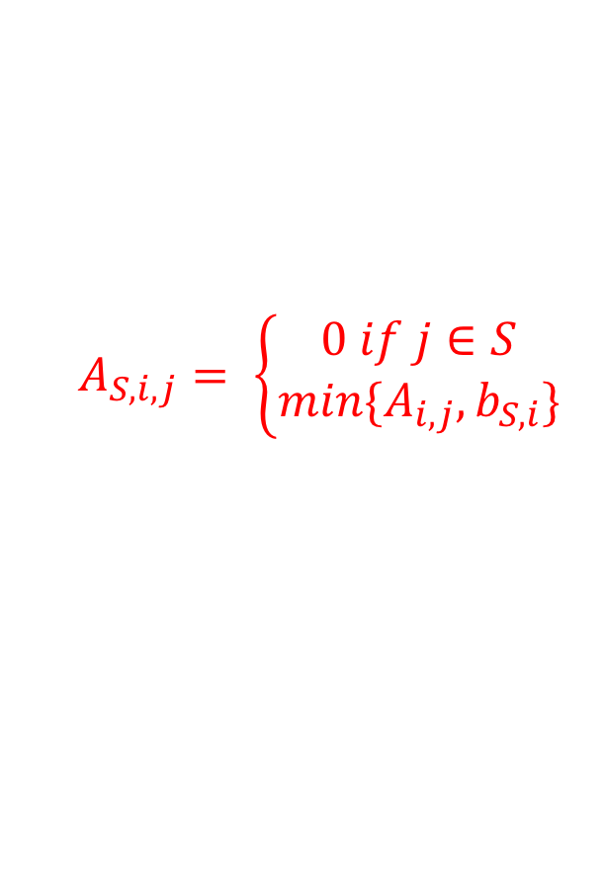
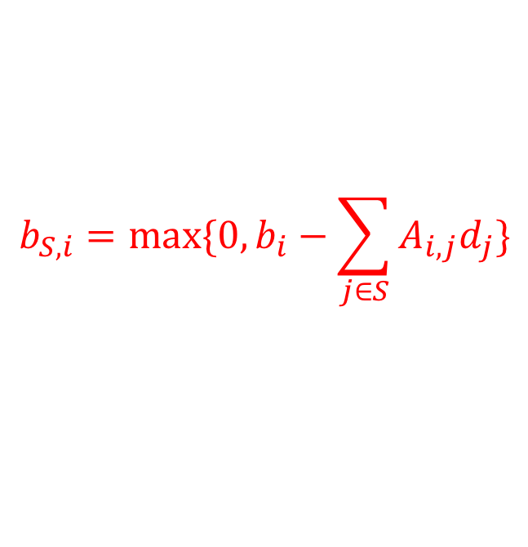
Knapsack Cover Inequalities
Basic-LP has large integrality gap for CIP
[Carr-Fleischer-Leung-Phillips’00] KC-inequalities
min $\sum_{j=1}^{n}{c_{j}x_{j}}$
$Ax≥b$
$x≤d$
$x≥0$
min $\sum_{j=1}^{n}{c_{j}x_{j}}$
$A_{S}x≥b_{S} for all S⊂[n]$
$x≥0$
$$b_{S,i}=max⁡\{0, b_{i}−\sum_{j∈S}{A_{i,j}d_{j}\}}$$
$$A_{S,i,j}= \left\{\begin{aligned}0 if j∈S \\ min\{A_{i,j}, b_{S,i}\}\end{aligned}\right.$$

Slide 9
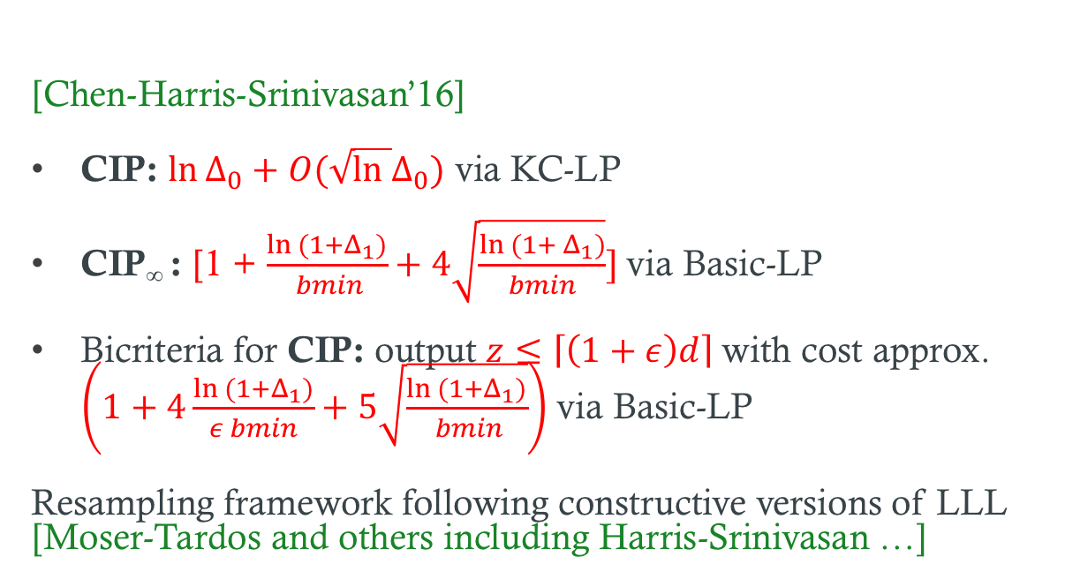
Approximating CIPs
Focus of this talk: $Δ_{0}$, $Δ_{1 }$ are $≥$ some fixed constant C
[Chen-Harris-Srinivasan’16]
CIP: $\ln{Δ_{0}+O(\sqrt{ln }Δ_{0})}$ via KC-LP
CIP∞ : [1 + $\frac{ln {(1+Δ}_{1})}{ bmin}+4\sqrt{\frac{ln (1+ Δ_{1})}{bmin}}]$via Basic-LP
Bicriteria for CIP: output $z≤\left\lceil \left(1+ε\right)d\right\rceil$with cost approx. $\left(1+4\frac{ln (1+Δ_{1})}{ε bmin}+5\sqrt{\frac{ln {(1+Δ}_{1})}{ bmin}}\right)$ via Basic-LP
Resampling framework following constructive versions of LLL [Moser-Tardos and others including Harris-Srinivasan …]

Slide 10

∆₁ bound
$Δ$₁ can be much smaller than $Δ$₀
More robust to noise in data
Technically interesting

Slide 11
Our Results
Fast approximation scheme for solving KC-LP
Simple and (slightly) improved approximations for CIP and CIP∞ based on round+fix framework
Easy derandomization of algorithms: first deterministic algorithms with near-tight bounds

Slide 12
Solving KC-LP
[Carr etal]
Ellipsoid method via separation oracle for Knapsack Cover.
MWU based approximation scheme. (1+ε)-approximation in O(nN log C poly(1/ε)) time
Our result: O(N log C poly(1/ε)) time. Near-linear if C is poly-bounded

Slide 13
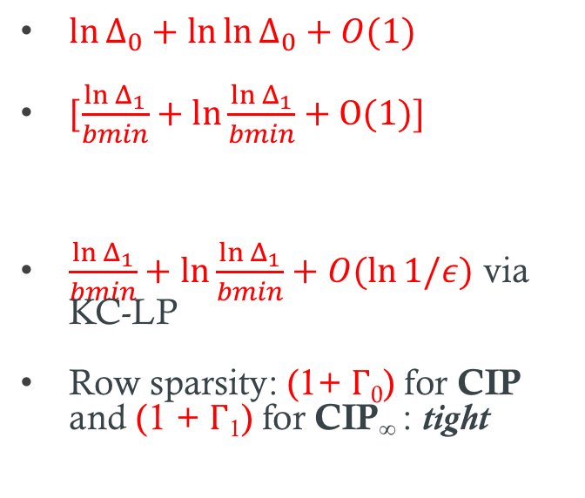
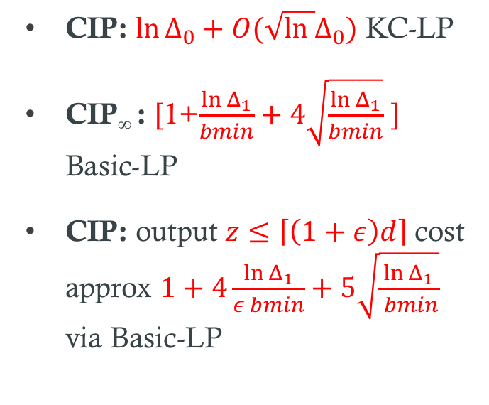
Approximation Bounds
[Chen-Harris-Srinivasan’16]
New
CIP: $\ln{Δ_{0}+O(\sqrt{ln }Δ_{0})}$ KC-LP
CIP∞ : [1+$\frac{\ln{Δ_{1}}}{bmin}+4\sqrt{\frac{ln Δ_{1}}{bmin}}$ ] Basic-LP
CIP: output $z≤\left\lceil \left(1+ε\right)d\right\rceil$cost approx $1+4\frac{ln Δ_{1}}{ε bmin}+5\sqrt{\frac{ln Δ_{1}}{ bmin}}$ via Basic-LP
$\ln{Δ_{0}+\ln{\ln{Δ_{0}+O(1)}}}$
[$\frac{\ln{Δ_{1}}}{bmin}+ln\frac{\ln{Δ_{1}}}{bmin}+O(1)]$
$\frac{\ln{Δ_{1}}}{bmin}+ln\frac{\ln{Δ_{1}}}{bmin}+O(\ln{1/ε)}$ via KC-LP
Row sparsity: (1+ Γ₀) for CIP and (1 + Γ₁) for CIP∞ : tight
Focus of this talk: $Δ_{0}$, $Δ_{1 }$ are $≥$ some fixed constant C

Slide 14
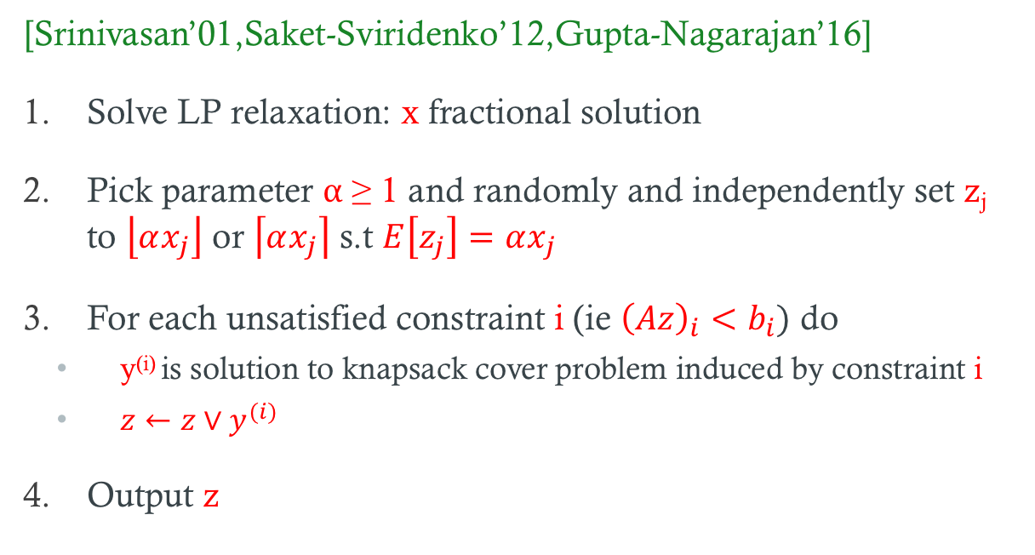
Round+Fix Algorithm
[Srinivasan’01,Saket-Sviridenko’12,Gupta-Nagarajan’16]
Solve LP relaxation: x fractional solution
Pick parameter α ≥ 1 and randomly and independently set z_{j} to $\left\lfloor αx_{j}\right\rfloor$ or $\left\lceil αx_{j}\right\rceil$ s.t $E\left[z_{j}\right]=αx_{j}$
For each unsatisfied constraint i (ie ${\left(Az\right)}_{i}<b_{i})$ do
  y^{(i)} is solution to knapsack cover problem induced by constraint i
  $z←z∨y^{(i)}$
Output z

Slide 15
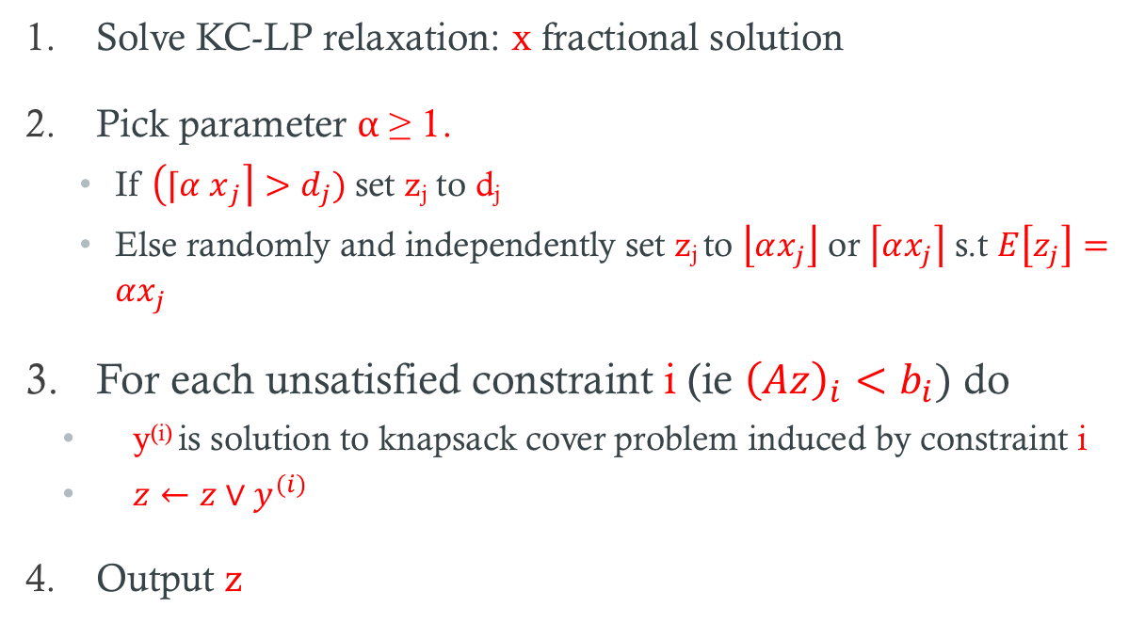
Round+Fix Algorithm for CIP
Solve KC-LP relaxation: x fractional solution
Pick parameter α ≥ 1.
  If $\left({⌈α x}_{j}\right\rceil >d_{j})$set z_{j} to d_{j}
  Else randomly and independently set z_{j} to $\left\lfloor αx_{j}\right\rfloor$ or $\left\lceil αx_{j}\right\rceil$ s.t $E\left[z_{j}\right]=αx_{j}$
For each unsatisfied constraint i (ie ${\left(Az\right)}_{i}<b_{i})$ do
  y^{(i)} is solution to knapsack cover problem induced by constraint i
  $z←z∨y^{(i)}$
Output z

Slide 16
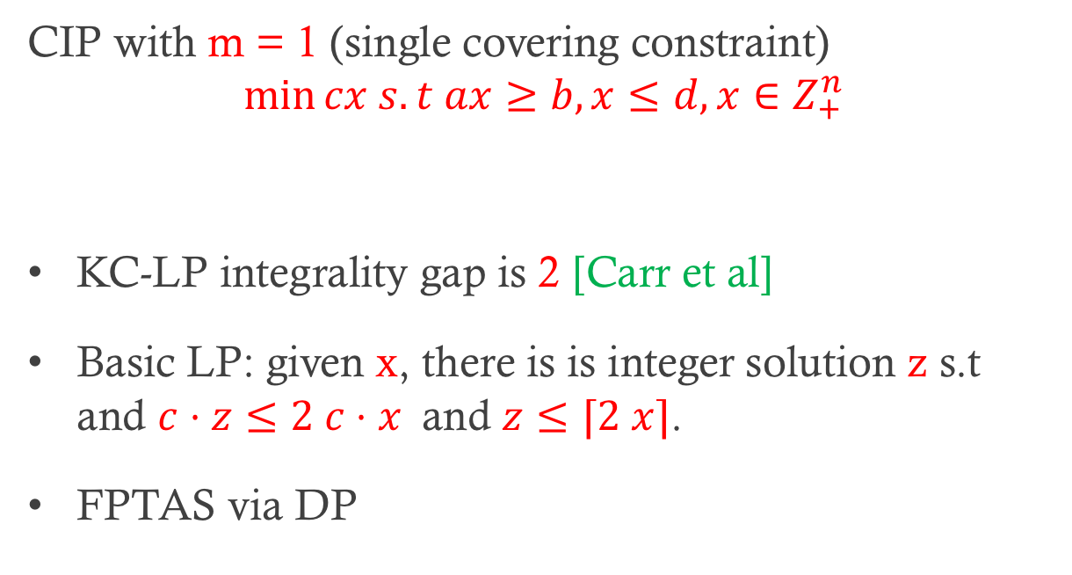
Knapsack Cover
CIP with m = 1 (single covering constraint)
$$\min{cx s.t ax≥b, x≤d, x∈Z_{+}^{n}}$$
KC-LP integrality gap is 2 [Carr et al]
Basic LP: given x, there is is integer solution z s.t and $c⋅z≤2 c⋅x$and $z≤⌈2 x⌉$.
FPTAS via DP

Slide 17

High-level Analysis of Round+Fix
Output is feasible solution by construction
Expected cost?
  p_{i} : probability that i not covered
  $α c⋅x+\sum_{i}{p_{i} (c⋅y^{\left(i\right)})}$

Slide 18
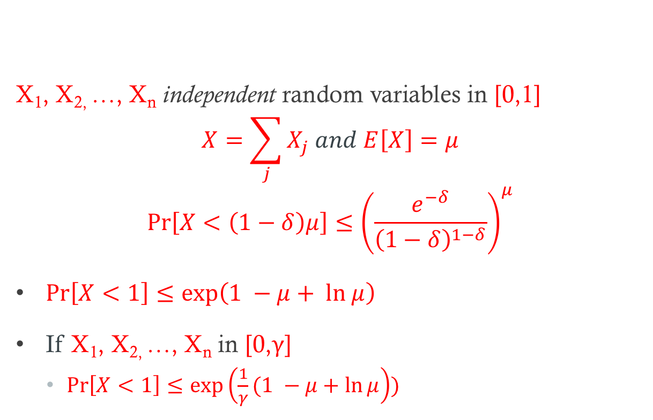
Only tool: Chernoff Bound
X₁, X_{2,} …, X_{n} independent random variables in [0,1]
$$X=\sum_{j}{X_{j} and E\left[X\right]=μ}$$
$$\operatorname{Pr}\left[X<\left(1−δ\right)μ\right]≤{\left(\frac{e^{−δ}}{{\left(1−δ\right)}^{1−δ}}\right)}^{μ}$$
$\operatorname{Pr}\left[X<1\right]≤\exp\left(1 −μ+ ln μ\right)$
If X₁, X_{2,} …, X_{n} in [0,γ]
  $\operatorname{Pr}\left[X<1\right]≤\exp\left(\frac{1}{γ}(1 −μ+\ln{μ}\right))$

Slide 19
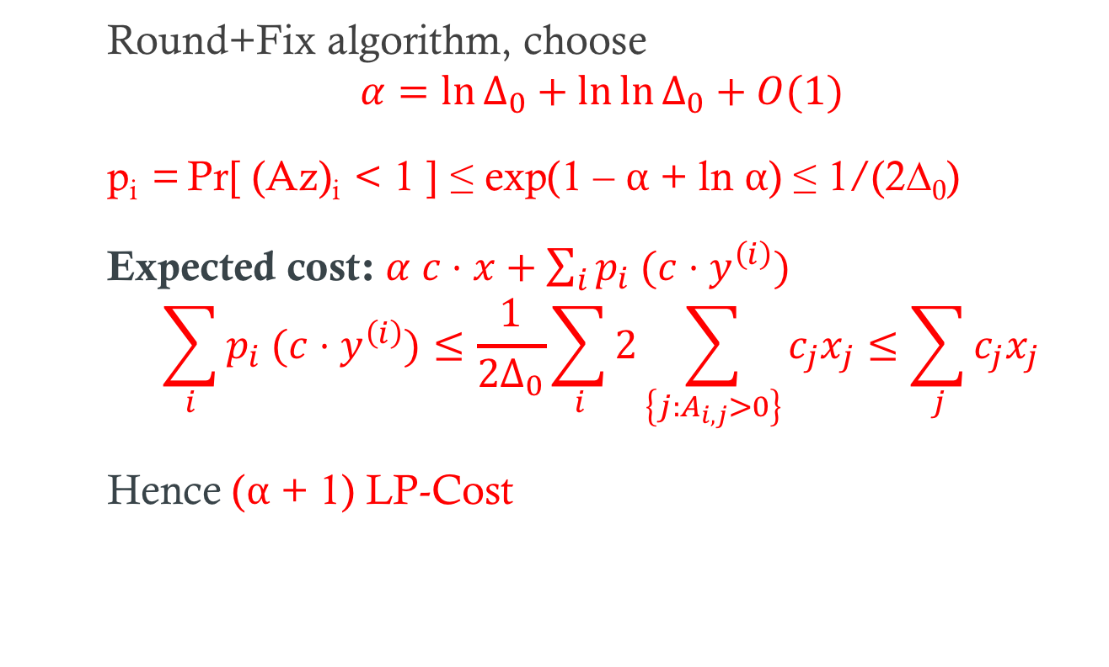
CIP∞: Ax ≥ 1, x ≥ 0
Round+Fix algorithm, choose
$$α=\ln{Δ_{0}+\ln{\ln{Δ_{0}+O(1)}}}$$
p_{i} = Pr[ (Az)_{i} < 1 ] ≤ exp(1 – α + ln α) ≤ 1/(2∆₀)
Expected cost: $α c⋅x+\sum_{i}{p_{i} (c⋅y^{\left(i\right)})}$
$$\sum_{i}{p_{i} (c⋅y^{\left(i\right)})}≤\frac{1}{{2Δ}_{0}}\sum_{i}{2\sum_{\left\{j:A_{i,j}>0\right\}}{c_{j}x_{j}≤\sum_{j}{c_{j}x_{j}}}}$$
Hence (α + 1) LP-Cost

Slide 20

CIP: Ax ≥ 1, x ≤ d, x ≥ 0
Round+Fix algorithm, choose
$$α=\ln{Δ_{0}+\ln{\ln{Δ_{0}+O(1)}}}$$
Same analysis gives α + 1 approx. wrt KC-LP

Slide 21
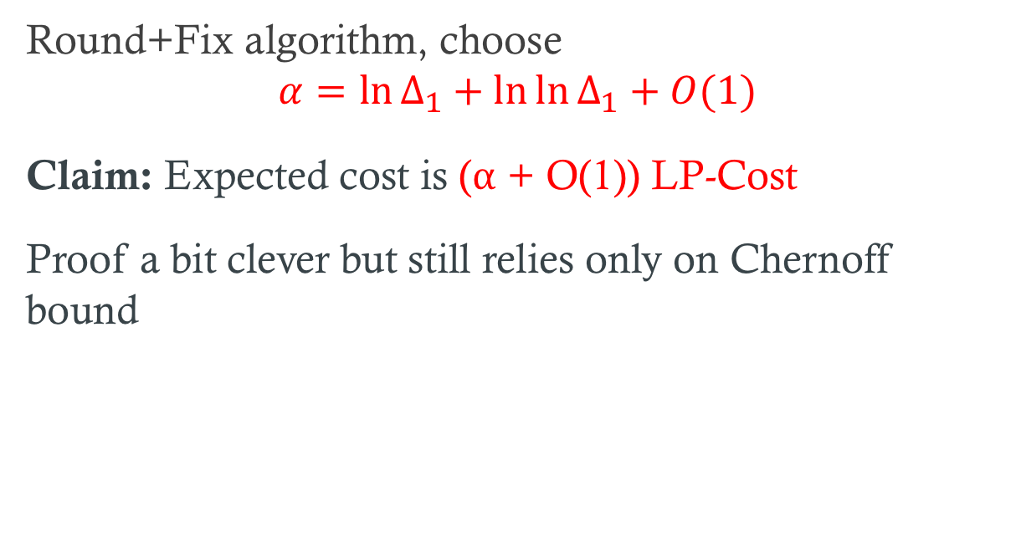
CIP∞: Ax ≥ 1, x ≥ 0, ∆₁ bound
Round+Fix algorithm, choose
$$α=\ln{Δ_{1}+\ln{\ln{Δ_{1}+O(1)}}}$$
Claim: Expected cost is (α + O(1)) LP-Cost
Proof a bit clever but still relies only on Chernoff bound

Slide 22
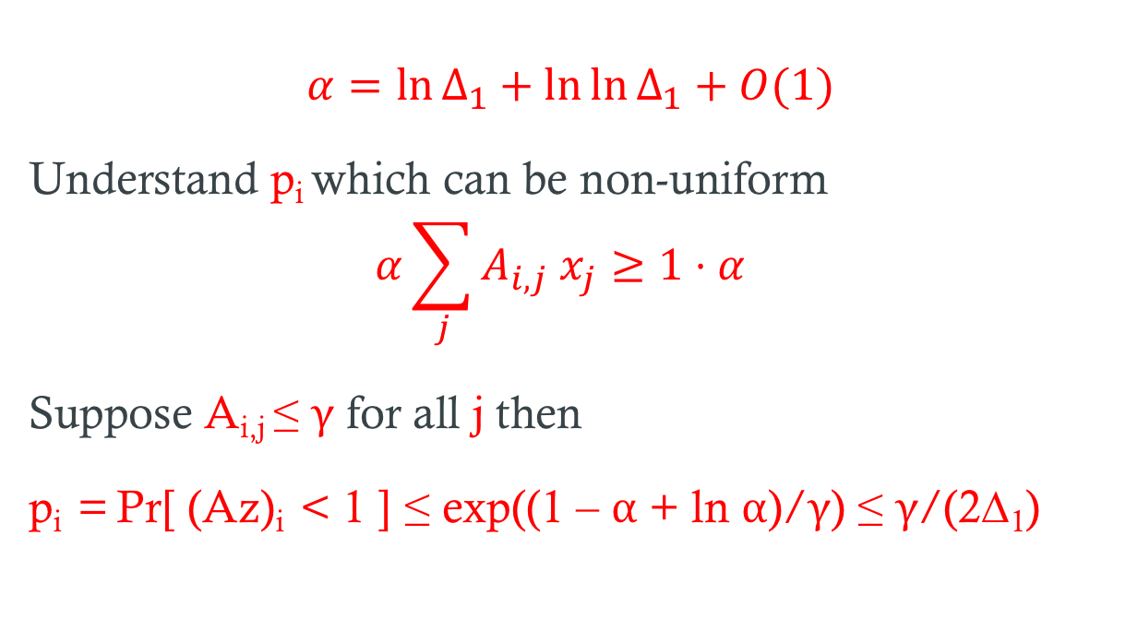
∆₁ bound: intuition
$$α=\ln{Δ_{1}+\ln{\ln{Δ_{1}+O(1)}}}$$
Understand p_{i} which can be non-uniform
$$α\sum_{j}{A_{i,j} x_{j}≥1⋅α }$$
Suppose A_{i,j} ≤ γ for all j then
p_{i} = Pr[ (Az)_{i} < 1 ] ≤ exp((1 – α + ln α)/γ) ≤ γ/(2∆₁)

Slide 23
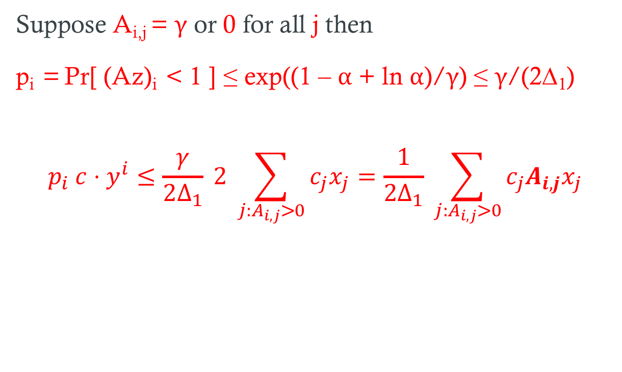
∆₁ bound: intuition
Suppose A_{i,j} = γ or 0 for all j then
p_{i} = Pr[ (Az)_{i} < 1 ] ≤ exp((1 – α + ln α)/γ) ≤ γ/(2∆₁)
$$p_{i} c⋅y^{i}≤\frac{γ}{{2Δ}_{1}} 2 \sum_{j:A_{i,j}>0}{c_{j}x_{j}=\frac{1}{2Δ_{1}} \sum_{j:A_{i,j}>0}{c_{j}A_{i,j}x_{j}}}$$

Slide 24
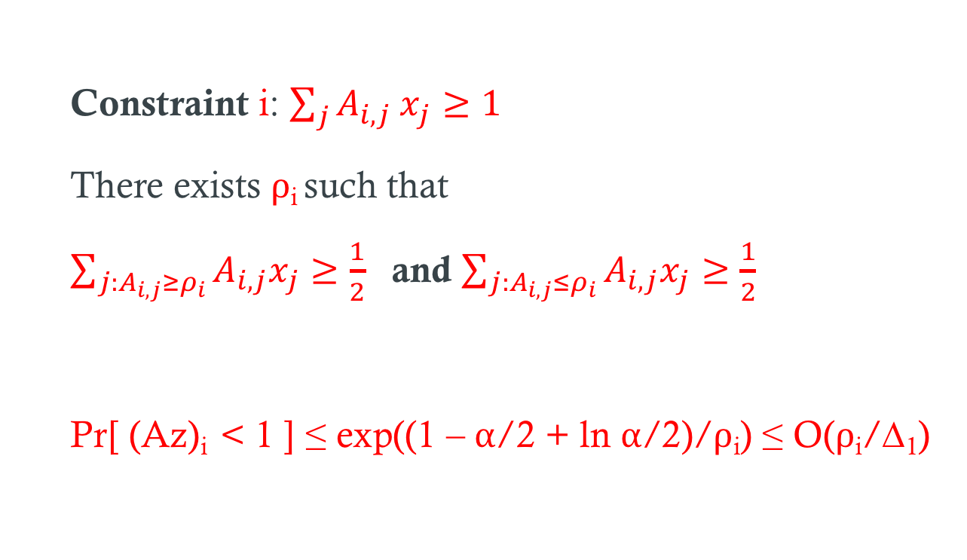
∆₁ bound: general case
Constraint i: $\sum_{j}{A_{i,j} x_{j}≥1}$
There exists ρ_{i} such that
$\sum_{j:A_{i,j}≥ρ_{i}}{A_{i,j}x_{j}≥\frac{1}{2} }$ and $\sum_{j:A_{i,j}≤ρ_{i}}{A_{i,j}x_{j}≥\frac{1}{2} }$
Pr[ (Az)_{i} < 1 ] ≤ exp((1 – α/2 + ln α/2)/ρ_{i}) ≤ O(ρ_{i}/∆₁)

Slide 25
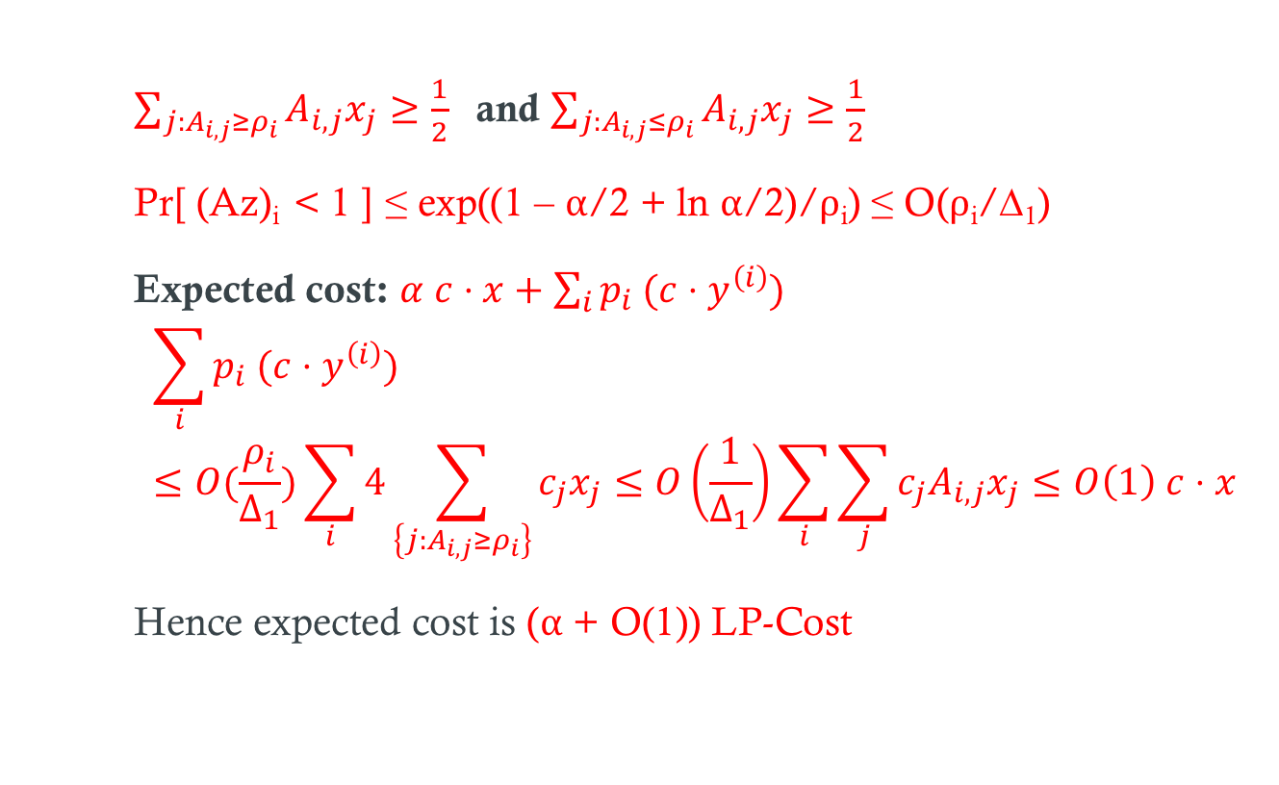
∆₁ bound: general case
$\sum_{j:A_{i,j}≥ρ_{i}}{A_{i,j}x_{j}≥\frac{1}{2} }$ and $\sum_{j:A_{i,j}≤ρ_{i}}{A_{i,j}x_{j}≥\frac{1}{2} }$
Pr[ (Az)_{i} < 1 ] ≤ exp((1 – α/2 + ln α/2)/ρ_{i}) ≤ O(ρ_{i}/∆₁)
Expected cost: $α c⋅x+\sum_{i}{p_{i} (c⋅y^{\left(i\right)})}$
$$\sum_{i}{p_{i} (c⋅y^{\left(i\right)})}≤O(\frac{ρ_{i}}{Δ_{1}})\sum_{i}{4\sum_{\left\{j:A_{i,j}≥ρ_{i}\right\}}{c_{j}x_{j}≤O\left(\frac{1}{Δ_{1}}\right)\sum_{i}{\sum_{j}{c_{j}A_{i,j}x_{j}≤O\left(1\right) c⋅x}} }}$$
Hence expected cost is (α + O(1)) LP-Cost

Slide 26
Derandomization
Algorithm is simple. Feasibility guaranteed, only cost is random. Analysis relies only on simple Chernoff bound
Use method of conditional expectations via Chernoff bound derivation-formula as pessimistic estimator
Easy and efficient deterministic algorithm

Slide 27
Conclusions
Fast (near-linear) approximation scheme to solve KC-LP
Randomized rounding + fixing appears to be a universal algorithm for Set Cover and CIPs: for each scenario different parameter α.
  Algorithm: try “all” values of α and take the best. Oblivious to parameters and may work better in practice.
Derandomization

Slide 28
Thank You!

