Slide 1
k-Cut in Graphs and Hypergraphs
Chandra Chekuri
Univ. of Illinois, Urbana-Champaign
Joint work with Karthik Chandrasekaran
Dartmouth Theory Seminar, Oct 30, 2020: Online talk

Slide 2
Overview
Part I
Introduce Graph k-cut and some known results
Hypergraph k-cut and recent results
Submodular k-partition and open problems
Part II
[Goldschmidt-Hochbaum’88] approach to Graph k-cut
[Chandrasekaran-C’20] on Hypergraph k-cut
Concluding remarks

Slide 3
Overview
Part I
Introduce Graph k-cut and some known results
Hypergraph k-cut and recent results
Submodular k-partition and open problems
Part II
[Goldschmidt-Hochbaum’88] approach to Graph k-cut
[Chandrasekaran-C’20] on Hypergraph k-cut
Concluding remarks

Slide 4
Familiar Cut Problems
Input: G=(V,E) undirected graph
Goal: remove as few edges as possible such that
s-t mincut: s, t in different connected components
global mincut: two (or more) connected components

Slide 5
s-t mincut and global mincut
Classical polynomial-time solvable problems via max-flow or via submodular function minimization
Many applications and connections. Substantial recent and ongoing work on several aspects
Traditionally global mincut solved via s-t mincut. However global mincut has additional structure that can be exploited algorithmically

Slide 6
Multiterminal/Multiway Cut
Input: G=(V,E) and terminals $S=\left\{s_{1},s_{2},…,s_{k}\right\} ⊆V$
Goal: remove as few edges as possible such that terminals are separated

Slide 7
Multiterminal/Multiway Cut
Input: G=(V,E) and terminals $S=\left\{s_{1},s_{2},…,s_{k}\right\} ⊆V$
Goal: remove as few edges as possible such that terminals are separated
k = 2 is s-t mincut and hence poly-time solvable
k = 3 is NP-Hard and APX-Hard to approximate [Dalhaus etal ’94]
Best current approximation: 1.2965 [Sharma-Vondrak’14]

Slide 8
Graph k-Cut
Input: undirected graph G=(V,E) and integer k
Goal: find smallest cardinality subset of edges $E’$ such that $G−E’$ has at least k connected components

Slide 9
Graph k-Cut: Partition view
Input: undirected graph G=(V,E) and integer k
Goal: partition of V into non-empty parts $\left(V_{1},V_{2},…,V_{k}\right)$ that minimizes # of edges crossing partition

Slide 10
Complexity of Graph k-Cut
Polynomial-time solvable for any fixed k [Goldschmidt-Hochbaum’88, other approaches later]
NP-Hard when k is part of input [GH’88]
$2\left(1−\frac{1}{k}\right)$-approximation [Saran-Vazirani’94, …]
$(2−ε)$-approximation unlikely [Manurangsi’17]
Several results on FPT and fine-grained complexity

Slide 11
Polytime Algorithms for k-Cut
[Goldschmidt-Hochbaum’88,’94] $n^{O(k^{2})}$ time deterministic algorithm via S-T cuts
[Karger’93, Karger-Stein’95] random contraction: Montecarlo algorithm, $n^{2k−2}poly(log n)$ time whp
[Kamidoi-Yoshida-Nagamochi’07] $n^{4k+O(1)}$ time deterministic algorithm (improving [GH])
[Thorup’08] tree packing based deterministic algorithm $n^{2k+O(1)}$ time

Slide 12
Poly-time Algorithms for k-Cut: recent developments
[Gupta-Harris-Lee-Li’20] Karger-Stein algorithm runs in ${O(n}^{k})$ time whp which is near optimal under conditional k-clique hardness
[C-Quanrud-Xu’18] reinterpret (and simplify) Thorup’s tree packing based approach via k-Cut LP relaxation. Results in slightly improved deterministic algorithm which is fastest currently

Slide 13
Motivating Questions
“Why” is Graph k-Cut solvable in polynomial time for fixed k?
Generalize to Hypergraph k-Cut?
Generalize to Submodular k-Partition?

Slide 14
Hypergraphs
G=(V,E) vertices, hyperedges
hyperedge: subset of vertices
$$e∈E⇒e⊆V$$
Motivation:
direct applications
connection to vertex capacities
special case of submodular functions generalizing graph cut function

Slide 15
Hypergraph k-Cut
Input: hypergraph G=(V,E) and integer k
Goal: find partition of V into non-empty parts $\left(V_{1},V_{2},…,V_{k}\right)$ that minimizes # of hyperedges crossing partition

Slide 16
Hypergraph k-Cut
k=2 is global mincut for hypergraphs
Solvable via s-t mincut in directed graphs [Lawler’72]
Also via [Nagamochi-Ibaraki’92] ordering approach [Klimmek-Wagner’96, Queyranne’98, Mak-Wong’00, C-Xu’17]
Non-obvious questions: complexity/approximability when k is fixed and when k is part of input

Slide 17
Hypergraph k-Cut: Progress
[Xiao’08] polynomial time algorithm for k=3
[Fukunaga’13] algorithm for constant rank via hyper-tree packing, also via random contraction [Karger, Karger-Stein]. Exponent in running time depends on rank
[Chandrasekaran-Xu-Yu’18] randomized Montecarlo algorithm when k is fixed (random contraction )
[Chandrasekaran-C’20] deterministic polytime algorithm when k is fixed
[C-Li’15] hard to approximate within almost polynomial factors when k is part of input. Via reduction from k-Densest-Subgraph problem and [Manurangsi’16]

Slide 18
Further generalization: Submodular k-Partition
[Queyranne’98, Zhao-Nagamochi-Ibaraki’04, Okumoto-Fukunaga-Nagamochi’12, Guinez-Queyranne’12]
To what extent does submodularity play a role in Graph k-Cut and Hypergraph k-Cut and related partitioning problems?

Slide 19
Submodular Set Functions
A real valued set function $f:2^{N}→R$is submodular if
f(A+j) – f(A) ≥ f(B+j) – f(B) for all A ⊆ B and j ∉ B
j
A
B
Equivalently
f(A) + f(B) ≥ f(A⋃ B) + f (A ⋂ B) for all A,B ⊆ N

Slide 20
Cut functions in graphs/hypergraphs
G=(V,E) undirected graph/hypergraph
$f:2^{V}→R^{+}$ where f(S) = |δ(S)|
S

Slide 21
Submodular Set Functions
Monotone: f(A) ≤ f(B) for all A ⊆ B
Example: coverage in set systems, matroid rank function
Non-negative: f(A) ≥ 0 for all A
Example: cut function of directed graphs
Symmetric: f(A) = f(N\A) for all A
Example: cut function of undir graphs and hypergraphs

Slide 22
Submodular k-Partition
Input: submodular function $f:2^{V}→R$and integer k
Goal: partition V into non-empty parts $\left(V_{1},V_{2},…,V_{k}\right)$ that minimizes $\sum_{i}{f\left(V_{i}\right)=f\left(V_{1}\right)+f\left(V_{2}\right)+…+f(V_{k})}$

Slide 23
Submodular k-Partition
Input: submodular function $f:2^{V}→R$and integer k
Goal: partition V into non-empty parts $\left(V_{1},V_{2},…,V_{k}\right)$ that minimizes $\sum_{i}{f\left(V_{i}\right)=f\left(V_{1}\right)+f\left(V_{2}\right)+…+f(V_{k})}$
Special cases:
Sym-Submod-k-Part when f is symmetric. Graph k-Cut is a special case
Monotone-Submod-k-Part when f is monotone. Matroid k-Part when f is rank function of matroid
Hypergraph k-Cut

Slide 24
Submodular k-Partition
Known results:
[Okumoto-Fukunaga-Nagamochi’12] k=3 in P (inspired by [Xiao’08] for Hypergraph k-cut, k=3)
[Guinez-Queyranne’12] Sym-Submod in P for k=4

Slide 25
Overview
Part I
Introduce Graph k-cut and some known results
Introduce Hypergraph k-cut and recent results
Motivate Submodular k-Partition
Part II
[Goldschmidt-Hochbaum’88] approach to Graph k-cut
[Chandrasekaran-C’20] on Hypergraph k-cut
Concluding remarks

Slide 26
Graph k-Cut
G=(V,E) and integer k
Define $f\left(S\right)=\left|δ\left(S\right)\right|$ (submodular and symmetric)
$V_{1}^{∗},V_{2}^{∗},…,V_{k}^{∗}$ is optimum partition (assume unique for simplicity).

Slide 27
[GH] for Graph k-Cut
$V_{1}^{∗},V_{2}^{∗},…,V_{k}^{∗}$ is optimum partition (assume unique for simplicity).
Let $V_{1}^{∗}$ be smallest part: $f\left(V_{1}^{∗}\right)=\min_{j} f(V_{j}^{∗})$
[GH] algorithm at high-level
Base case: k=1, output V
Find smallest part $V_{1}^{∗}$
Recursively partition $G’=G[V−V_{1}^{∗}]$ into k-1 parts. Output these parts along with $V_{1}^{∗}$

Slide 28
[GH] for Graph k-Cut
Find smallest part $V_{1}^{∗}$
How?
Via S-T mincuts where $S, T⊆V, S∩T= ∅$

Slide 29
[GH] Main Structural Lemma
Find smallest part $V_{1}^{∗}$
Via S-T mincuts where $S, T⊆V, S∩T= ∅$
Key Lemma:
${|V}_{1}^{∗}|≤k−2$or
There exist $S, T with \left|S\right|≤k−2, \left|T\right|≤k−1$ such that min S-T cut is ${(V}_{1}^{∗}, V−V_{1}^{∗})$

Slide 30
[GH] Main Structural Lemma
$$S⊆V_{1 }^{∗}, \left|S\right|=k−2,$$
$$T⊆V−V_{1}^{∗}, \left|T∩V_{j}^{∗}\right|=1 for j=2,3,…,k$$

Slide 31
Using structural lemma
$∁_{1}=\{ A⊆V :\left|A\right|≤k−2 \}$
$∁_{2}=\{A⊆V :\left(A, V−A\right) is S−T mincut for some \left|S\right|≤k−2, \left|T\right|≤k−1\}$
$C=∁_{1}∪$ $∁_{2}$. $\left|C\right|≤n^{2k}$ and computable in similar time
By structural lemma $V_{1}^{∗}∈C$

Slide 32
Using structural lemma
High-Level Algorithm
Detailed Algorithm
Base case: k=1, output V
Find smallest part $V_{1}^{∗}$
Recursively partition $G’=G[V−V_{1}^{∗}]$ into k-1 parts. Output these parts along with $V_{1}^{∗}$
Base case: k=1, output V
Compute candidate set $C$ where $\left|C\right|≤n^{2k}$
For each $V_{1}∈C$
Recursively partition $G’=G[V−V_{1}]$ into k-1 parts. Compute value of k-partition obtained with $V_{1}$
Output least cost k-partition

Slide 33
Running Time
$$T\left(k\right)≤n^{2k} T\left(k−1\right)+poly\left(n^{2k}\right)$$
leading to $T\left(k\right)=n^{O\left(k^{2}\right)}$
[Kamidoi-Yoshida-Nagamochi’07] refine [GH] approach via divide-and-conquer (requires modified structural lemma) and obtain running time $n^{4k+O(1)}$

Slide 34
Comments on Proof of Structural Lemma
Proof relies on $V_{1}^{∗}$ being smallest part
[GH] use graph cut function properties and it is somewhat hard to understand proof
[Queyranne’98] claimed that [GH] proof generalizes to Sym-Submodular-k-Part to identify smallest part $V_{1}^{∗}$
[Chandrasekaran-C’20] New correct proof that relies only on submodularity and symmetry. Caveat: identifying $V_{1}^{∗}$ not sufficient to solve Sym-Submodular-k-Part but proof simplifies Graph k-Cut algorithm of [GH]

Slide 35
Hypergraph k-Cut
[Chandrasekaran-C’20]
Two deterministic algorithms
Simpler one running in time $mn^{O\left(k^{2}\right)}$
Divide-and-conquer approach in time $mn^{O\left(k\right)}$
Inspired by ideas in [GH’88], [OFN’12], [KYN’07]

Slide 36
Algorithmic Idea
Try to generalize [GH]
Identify smallest part via S-T cuts
Difficulties:
Hypergraph k-cut is not special case of Sym-Submod k-Part. In fact natural generalization of structural lemma with |S| = k-1 is false
For general Submod k-Partition, “smallest” part not meaningful

Slide 37
Algorithmic Idea
Key insight: Can identify any part via S-T cuts!
Specific to Hypergraph cut function and relies on its properties
Key idea, specific conjecture, and proof partly inspired by extensive experiments on small instances

Slide 38
Main Structural Lemma
$V_{1}^{∗},V_{2}^{∗},…,V_{k}^{∗}$ is optimum partition (assume unique for simplicity, otherwise need maximality)
Let $V_{i}^{∗}$ be an arbitrary part.

Slide 39
Main Structural Lemma
$V_{1}^{∗},V_{2}^{∗},…,V_{k}^{∗}$ is optimum partition (assume unique for simplicity, otherwise need maximality)
Let $V_{i}^{∗}$ be an arbitrary part. Then
There exists
$$S⊆V_{i}^{∗}, \left|S\right|≤2k−2 and$$
$T⊆V−V_{i}^{∗}, \left|T\right|≤k−1$
such that source maximal min S-T cut is ${(V}_{i}^{∗}, V−V_{i}^{∗})$

Slide 40
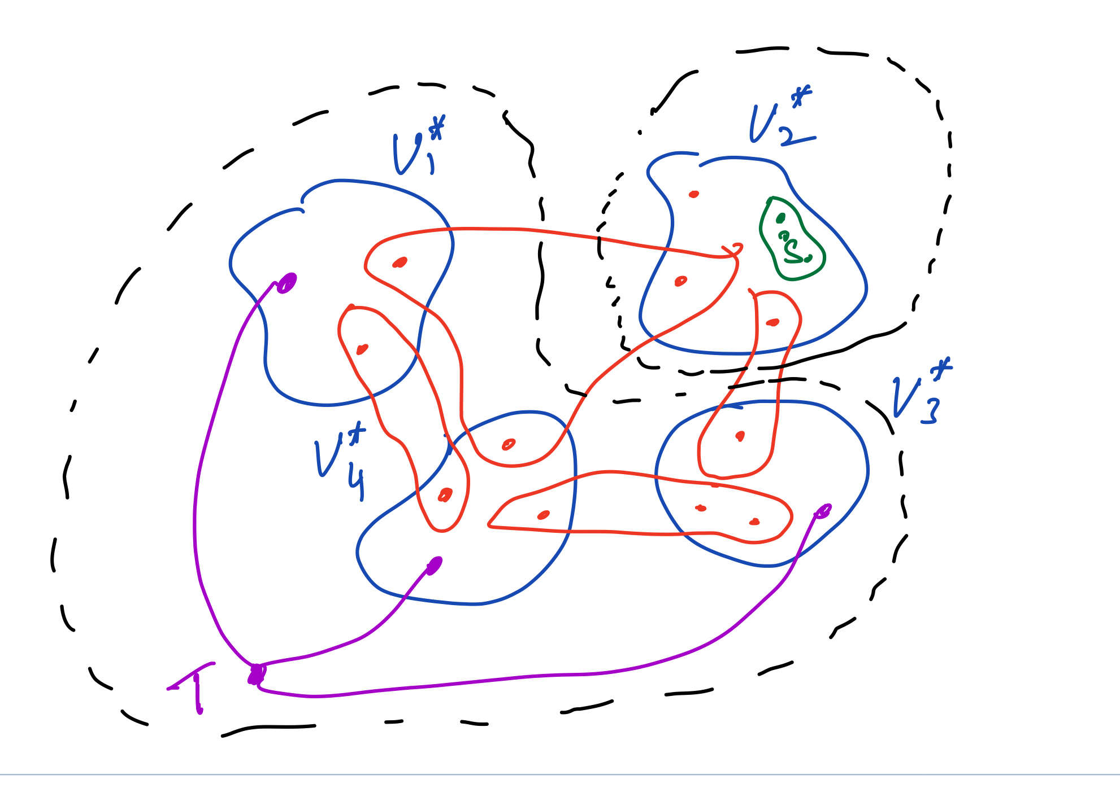

Slide 41
Algorithm
Via structural lemma, algorithm is very similar to that of [GH]
Running time is $mn^{O\left(k^{2}\right)}$
Improved running time of $mn^{O\left(k\right)}$ via divide-and-conquer approach and generalization of structural lemma (inspired by [KYN’07])

Slide 42
Comments/Discussion on Structural Lemma
Bound of (2k-2) in lemma is tight to identify arbitrary part, even for graphs
Part of the proof relies only on submodularity but other part specific to hypergraph cut function.

Slide 43
Overview
Part I
Introduce Graph k-cut and some known results
Hypergraph k-cut and recent results
Submodular k-partition and open problems
Part II
[Goldschmidt-Hochbaum’88] approach to Graph k-cut
[Chandrasekaran-C’20] on Hypergraph k-cut
Concluding remarks

Slide 44
Proof of Structural Lemma: High-level Ideas
$V_{1}^{∗},V_{2}^{∗},…,V_{k}^{∗}$ is optimum partition. Let $V_{i}^{∗}$ be an arbitrary part.
There exists $S⊆V_{i}^{∗}$ and $T⊆V−V_{i}^{∗}$ such that
$$S⊆V_{i}^{∗}, \left|S\right|≤2k−2 and$$
$T⊆V−V_{i}^{∗}, \left|T\right|≤k−1$
such that source maximal min S-T cut is ${(V}_{i}^{∗}, V−V_{i}^{∗})$

Slide 45
Containment property
$V_{1}^{∗},V_{2}^{∗},…,V_{k}^{∗}$ is optimum partition. Let $V_{i}^{∗}$ be an arbitrary part. Fix any $S⊆V_{i}^{∗}$ and any $T⊆V−V_{i}^{∗}$ such that $T∩V_{j}^{∗}≠∅, ∀j≠ i$. Let $(V_{S}, V−V_{S})$ be source-maximal S-T mincut.
Then $V_{S}⊆V_{i}^{∗}$.
Proof relies only on submodularity and hence holds for Submod-k-Partition

Slide 46
Leveraging containment property
Want to show that there exists $S⊆V_{i}^{∗}, \left|S\right| small$ such that $V_{S}=V_{i}^{∗}$
Why should small S exist?
If $V_{S}⊂V_{i}^{∗}$ (strict) then $\left|δ\left(V_{S}\right)\right|<|δ\left(V_{i}^{∗}\right)|$ since$\left(V_{i}^{∗}, V−V_{i}^{∗}\right)$ is also a valid S-T cut
If $V_{S}⊂V_{i}^{∗}$ for all $S⊆V_{i}^{∗}$ such that $\left|S\right|≤2k−2$then
intuition from graph case: can split up $V_{i}^{∗}$ and obtain a cheaper k-partition contradicting optimality of current partition

Slide 47
Suppose $V_{S}⊂V_{i}^{∗}$ for all $S⊆V_{i}^{∗}$ such that $\left|S\right|≤2k−2$
Pick $S⊆V_{i}^{∗}$ with $\left|S\right|=2k−2$and max $\left|δ\left(V_{S}\right)\right|$
Let $S=\left\{u_{1},u_{2},…, u_{2k−2}\right\}.$ Since $V_{S}⊂V_{i}^{∗}$ there exists $u_{0}∈V_{i}^{∗}−V_{S}$

Slide 48
Property of S
Lemma: For $1≤j≤2k−2$ let $S_{j}=S −u_{i}+u_{0}.$ Then ${u_{j} ∉V}_{S_{j}}$. (follows from submodularity)

Slide 49
Fingers
For $1≤j≤2k−2$ let $A_{j}=V −V_{S_{j}}$

Slide 50
Uncrossing Theorem
From fingers to cheaper partition
New partition $\left(P_{1},P_{2},…,P_{k}\right)$ cheaper than $\left(V_{1}^{∗},V_{2}^{∗},…,V_{k}^{∗}\right)$
Proof is technical (somewhat messy) and relies on hypergraph cut function
Same theorem does not hold for general submodular functions

Slide 51
Recap
Deterministic algorithm for Hypergraph k-Cut
Some new insights into Submodular k-Partition and special cases
[Chandrasekaran-C’20] Poly-time algorithm for Minmax Symmetric Submodular k-Partition

Slide 52
Open Problems
Complexity of Submodular k-Partition
Special cases: symmetric functions, Hypergraph k-Partition, coverage function, etc
Hypergraph k-cut
Enumeration of all optimal solutions
Parallel algorithms

Slide 53
Fin and Thanks!

