Slide 1
Speeding Up MWU Based Approximation Schemes and Some Applications
Chandra Chekuri
Univ. of Illinois, Urbana-Champaign

Slide 2
Based on joint work
Near-linear-time approximation schemes for some implicit fractional packing problems with Kent Quanrud, SODA 2017
Approximating the Held-Karp Bound for Metric TSP in Nearly-Linear Time with Kent Quanrud, ArXiv, 2017
Ongoing work with Kent Quanrud
On Multiplicative Weight Updates for Concave and Submodular Function Maximization, with Jayaram Thathachar and Jan Vondrak, ITCS 2015.

Slide 3
(Pure) Packing LP
v, A non-negative
n: dimension of problem (size of x)
m: number of rows of A (non-trivial constraints)
N: number of non-zeroes in A

Slide 4
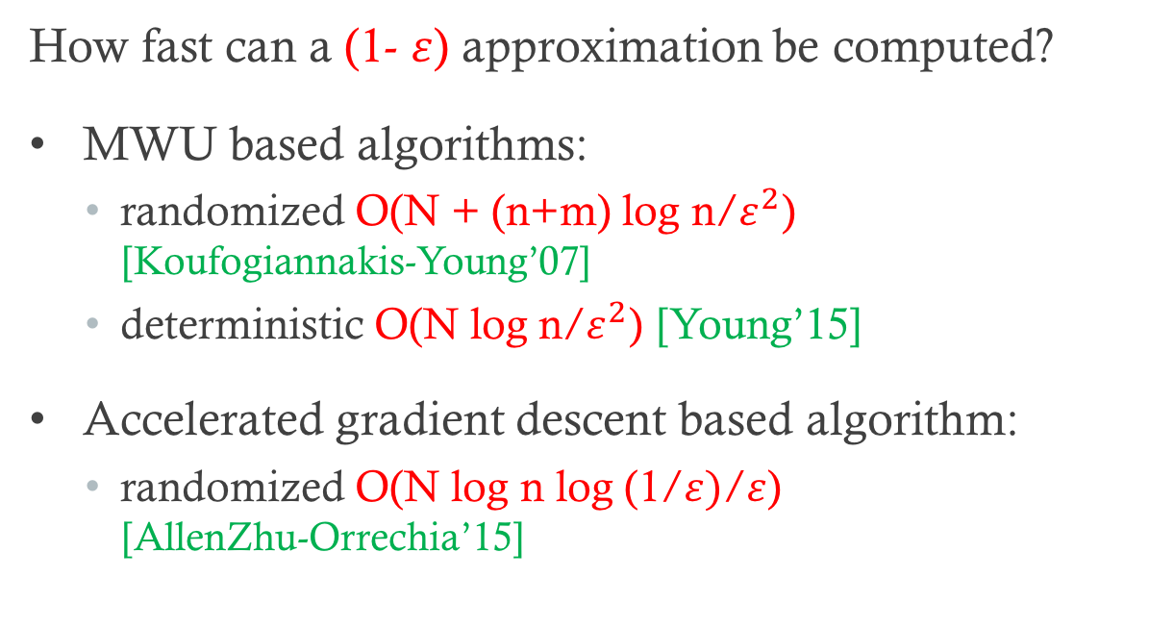
Explicit Packing Problems
How fast can a (1- $ε$) approximation be computed?
MWU based algorithms:
  randomized O(N + (n+m) log n/$ε^{2}$) [Koufogiannakis-Young’07]
  deterministic O(N log n/$ε^{2}$) [Young’15]
Accelerated gradient descent based algorithm:
  randomized O(N log n log (1/$ε)$/$ε$) [AllenZhu-Orrechia’15]

Slide 5
Implicit Packing Problems
Packing matrix A defined implicitly by a combinatorial structure
N is “large” in terms of original input

Slide 6
Packing Spanning Trees
Input: graph G=(V,E) edge capacities c_{e}
Goal: find a max fractional packing of spanning trees

Slide 7
Interval Packing
n closed intervals I₁, I₂, …, I_{n}: I_{i} = [a_{i}, b_{i}]
  I_{i} has size d_{i} and value v_{i}
m points p₁, p₂, …, p_{m} on real line
  p_{j} has capacity c_{j}

Slide 8
Interval Packing LP

Slide 9
TSP and Metric-TSP
TSP: Undir graph G=(V,E), edge costs c_{e}
  find Hamiltonian Cycle in G of minimum cost
Metric-TSP: Undir graph G=(V,E), edge costs c_{e}
  find spanning tour in G of minimum cost
  same as Hamiltonian Cycle in metric completion of G

Slide 10
Subtour Elimination LP for TSP

Slide 11
2ECSS LP
For Metric-TSP solving 2ECSS LP is equivalent to solving Subtour LP

Slide 12
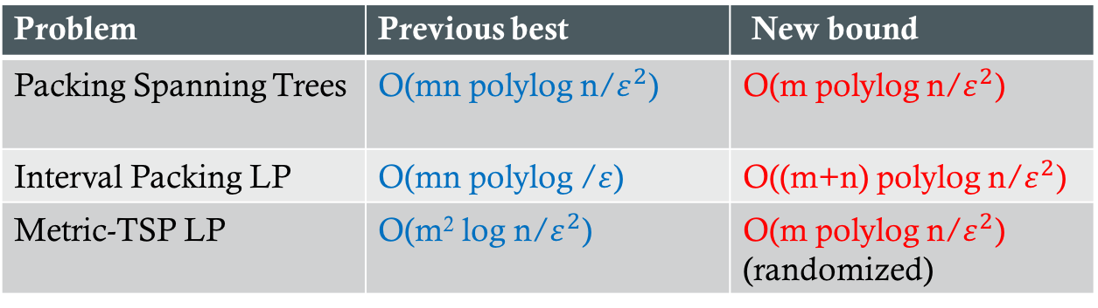
Faster Algorithms
Problem | Previous best | New bound
Packing Spanning Trees | O(mn polylog n/$ε^{2}$) | O(m polylog n/$ε^{2}$)
Interval Packing LP | O(mn polylog /$ε$) | O((m+n) polylog n/$ε^{2}$)
Metric-TSP LP | O(m² log n/$ε^{2}$) | O(m polylog n/$ε^{2}$) (randomized)
Ideas extend to covering and some mixed packing covering problems
Several applications to LPs for combinatorial problems

Slide 13
High-level Ideas
Speed up classical MWU based approximation schemes
Problem-specific integration of dynamic data structures for two separate issues
  oracle for MWU
  lazy weight update
Important observation: matrix A is 0,1 or column restricted (all non-zero entries in each column is same)

Slide 14
MWU
Maintain weights for constraints: w₁, w₂, …, w_{m}
In each iteration solve Lagrangean relaxation: collapse m constraints into one constraint
Take small step in direction of new solution
Update weights
Iterate until done

Slide 17
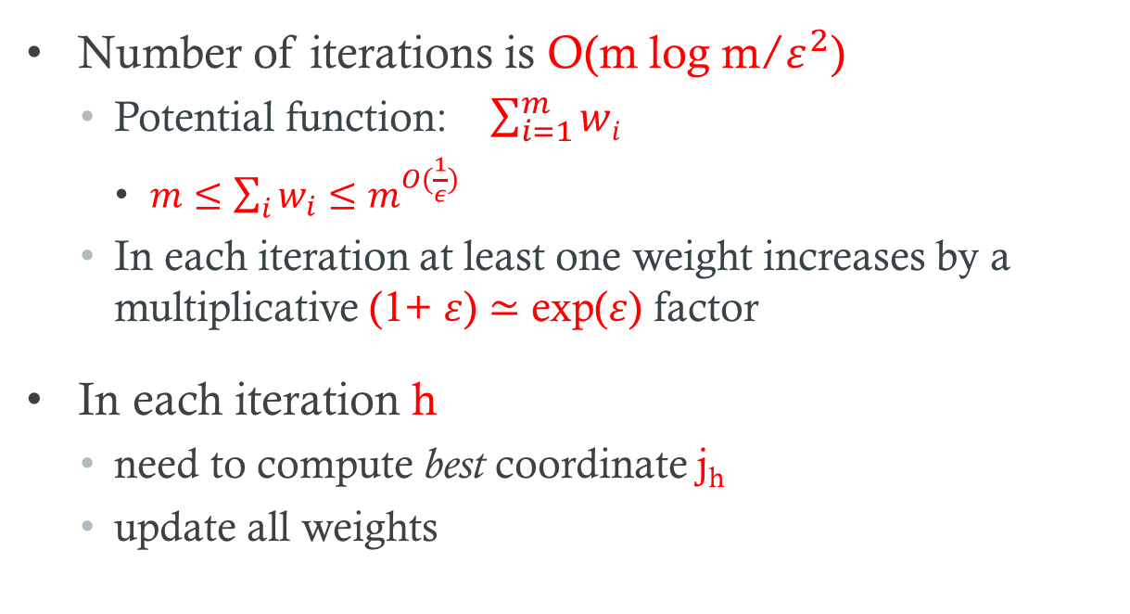
Simple Analysis
Number of iterations is O(m log m/$ε^{2}$)
  Potential function: $\sum_{i=1}^{m}{wi}$
    $m≤\sum_{i}{w_{i}≤m^{O(\frac{1}{ε})}}$
  In each iteration at least one weight increases by a multiplicative (1+ $ε$) $≃$ exp($ε$) factor
In each iteration h
  need to compute best coordinate j_{h}
  update all weights

Slide 18
Packing Spanning Trees
Input: graph G=(V,E) edge capacities c_{e}
Goal: find a max fractional packing of spanning trees

Slide 19
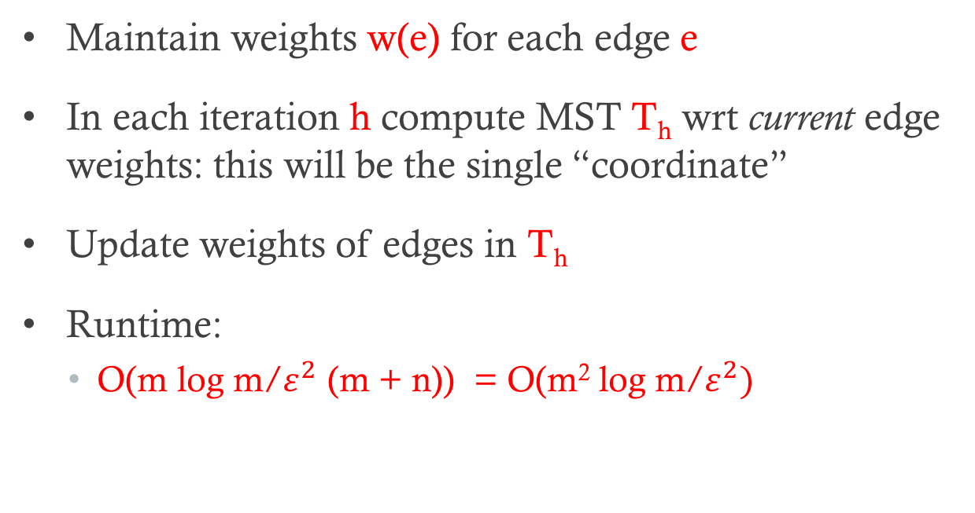
Applying MWU Framework
Maintain weights w(e) for each edge e
In each iteration h compute MST T_{h} wrt current edge weights: this will be the single “coordinate”
Update weights of edges in T_{h}
Runtime:
  O(m log m/$ε^{2}$ (m + n)) = O(m² log m/$ε^{2})$

Slide 20
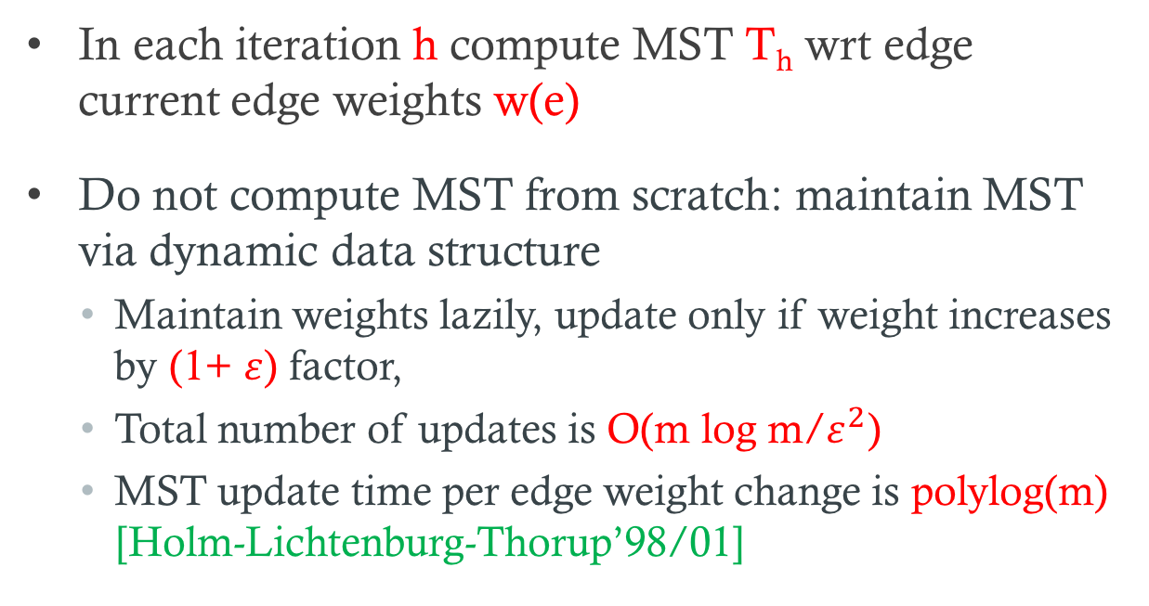
Improving run time via data structures
In each iteration h compute MST T_{h} wrt edge current edge weights w(e)
Do not compute MST from scratch: maintain MST via dynamic data structure
  Maintain weights lazily, update only if weight increases by (1+ $ε$) factor,
  Total number of updates is O(m log m/$ε^{2}$)
  MST update time per edge weight change is polylog(m) [Holm-Lichtenburg-Thorup’98/01]

Slide 21
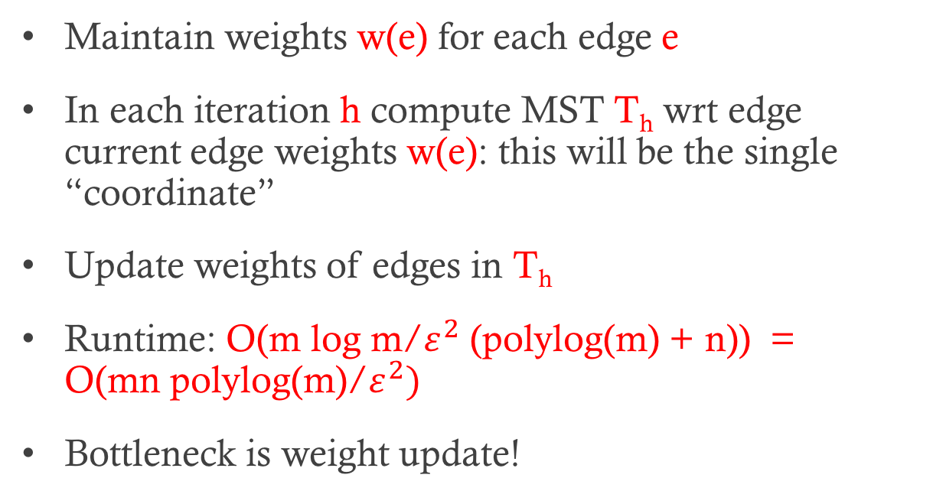
Applying MWU Framework
Maintain weights w(e) for each edge e
In each iteration h compute MST T_{h} wrt edge current edge weights w(e): this will be the single “coordinate”
Update weights of edges in T_{h}
Runtime: O(m log m/$ε^{2}$ (polylog(m) + n)) = O(mn polylog(m)/$ε^{2})$
Bottleneck is weight update!

Slide 22
Updating weights in each iteration

Slide 23
Updating weights in each iteration

Slide 24
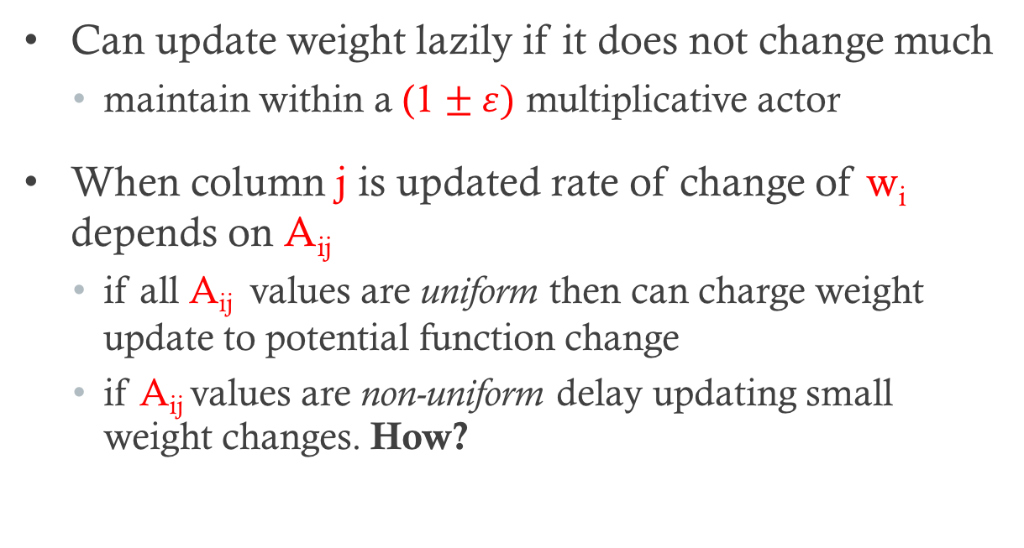
Updating weights lazily
Can update weight lazily if it does not change much
  maintain within a (1 $± ε)$ multiplicative actor
When column j is updated rate of change of w_{i} depends on A_{ij}
  if all A_{ij} values are uniform then can charge weight update to potential function change
  if A_{ij} values are non-uniform delay updating small weight changes. How?

Slide 25
Updating weights lazily
Borrow ideas from [Young]
Deterministically: Bucket A_{ij} values geometrically and lazily update using amortization
Randomization: touch/update w_{i} in proportion to 1/A_{ij}. For efficiency pick r from [0,1] and correlate
Crucial in spanning trees: all non-zero entries in each row are same because of 0,1 incidence matrix.

Slide 26
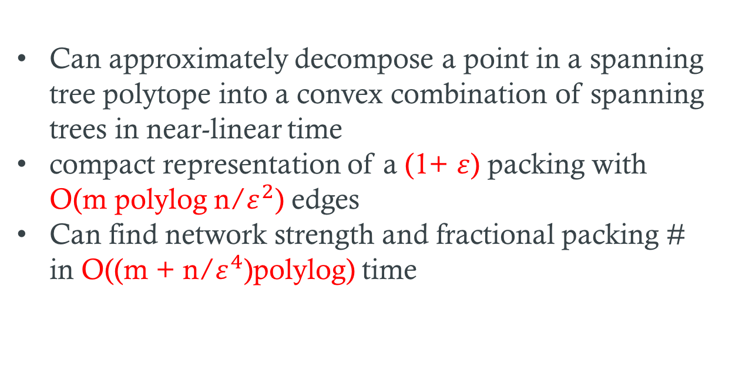
Packing Spanning Trees: Related Results
Can approximately decompose a point in a spanning tree polytope into a convex combination of spanning trees in near-linear time
compact representation of a (1+ $ε$) packing with O(m polylog n/$ε^{2}$) edges
Can find network strength and fractional packing # in O((m + n/$ε^{4}$)polylog) time

Slide 27
Interval Packing Problems

Slide 28
Main Idea
Use range tree data structures
Matrix A factorizes via range tree data structure into BC where B is row-sparse and C is column-sparse

Slide 29
Metric-TSP
Much more involved
Heavily builds on Karger’s near-linear time randomized mincut algorithm
Almost lucky?

Slide 30
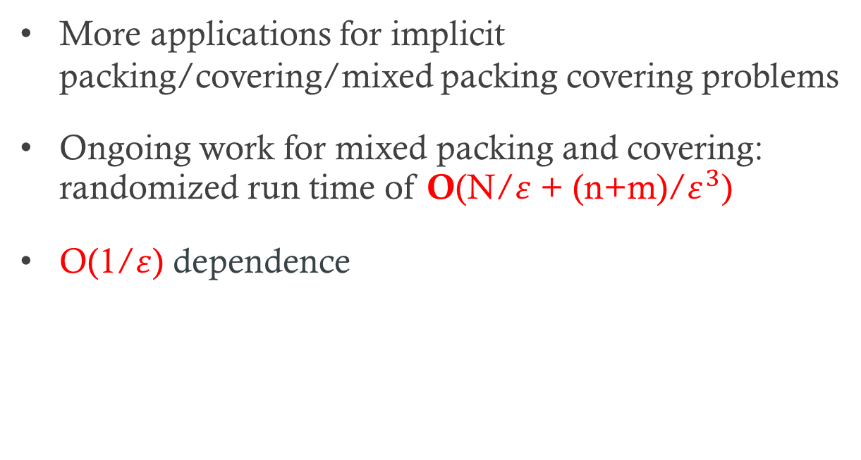
Open Problems
More applications for implicit packing/covering/mixed packing covering problems
Ongoing work for mixed packing and covering: randomized run time of O(N/$ε$ + (n+m)/$ε^{3}$)
O(1/$ε$) dependence

Slide 31
Thank You!

